Slide 1
CLD3 Processes, Platforms & Examples
Aaron Schroeder, Research Associate Professor
Social and Decision Analytics Division
CLD3 Workshop
March 25-26, 2019

Slide 2
CLD3 Processes, Platforms & Examples
Introduce some of our platforms as they are used in our data science process
Give some reasons why these platforms were selected
Show some examples that highlight the use of these platforms at different stages of the process
Including an example of finding data and creating decision making tools for policy makers in Marshalltown
Scenario: Visualizations for Policy Makers to Assess Possible Transit Route Changes
Demonstrate
Ingestion of various administrative data sources using multiple method
job locations
vulnerable population locations
transit route locations
Creation of statistical indexes and maps for sub-county geographies

Slide 3















INGEST
STORE & MANAGE
ANALYZE
PRESENT & SHARE
PUSH
RELATIONAL & SPATIAL
STATISTICAL
REST APIS
COLLECT
CODE
SPATIAL
PROJECT WIKIS
PULL
FILES
PARALLEL
DASHBOARDS
DOCKER SERVER CONTAINERIZATION
10 TB STORAGE, LVM / LUKS
Ubuntu Server 18.04.2 LTS, 64 CORES, 98GB RAM

Slide 4
VPS + Containerization = Data Ingestion Versatility!
Simple Parallel
Simple Additional IP Addresses (for cloud VPS services – use multiple NICs if running your own iron)
Recent example: NSF project studying the value of Open Source Software
Needed many R installations to download just about every R and Python repository on Github!
Needed to determine the license being used on each using an online service licenses.io that limits the rate of use by your IP address. So needed multiple IP addresses
Virtual Private Server
(Cloud or Yours)

Slide 5
Data Ingestion
Establish type and method of data transfer
pushed to or pulled into the cooperative platform?
staying where it is and being dynamically queried in a federated manner as needed?
Establish the best transfer protocol(s) to use given the types and method of transfer
e.g. SFTP, secure Dropbox, secured REST API, VT SAFR-Data Adapter for secure federated queries
Establish designed collection systems (e.g. behavioral experiments)
Establish data marshaling processes
system mediation logic, data pipeline and data transformation, transfer schedule, and data provenance maintenance
Establish secure data storage procedures
e.g. each project being stored on a new project-dedicated encrypted partition, original data being stored as non-removable and non-editable

Slide 6
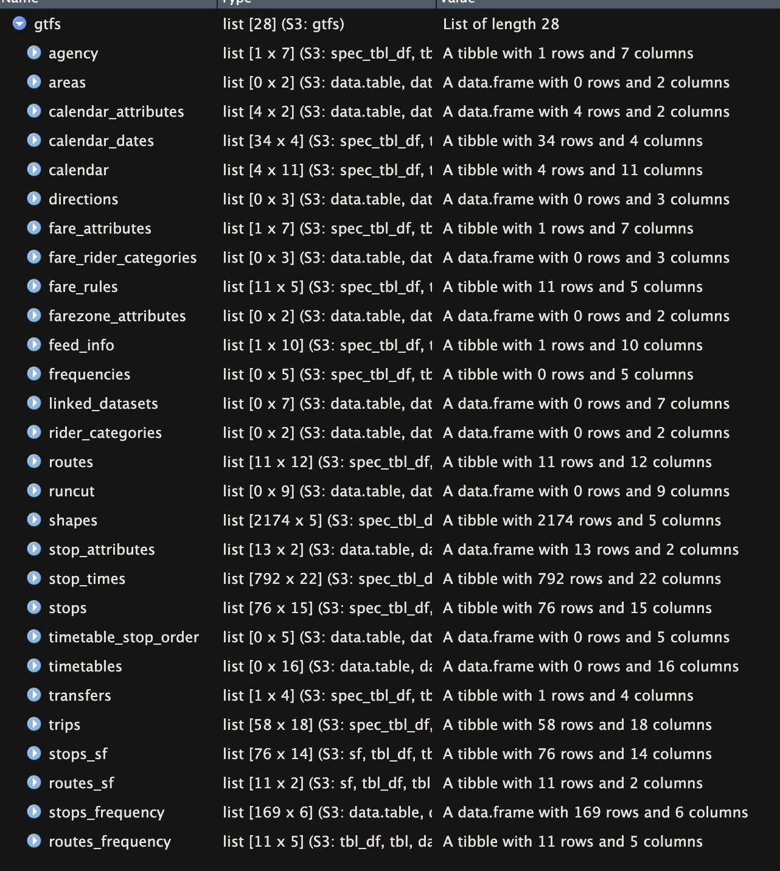
Data Ingestion Libraries/Packages
library(tidytransit)
# get Marshalltown feed URL
feed_url <- feedlist_df %>%
setDT(.) %>%
.[loc_t %like% "Marshalltown, IA", url_i]
# read gtfs data from url
gtfs <- read_gtfs(feed_url, geometry = TRUE, frequency = TRUE)

Slide 7
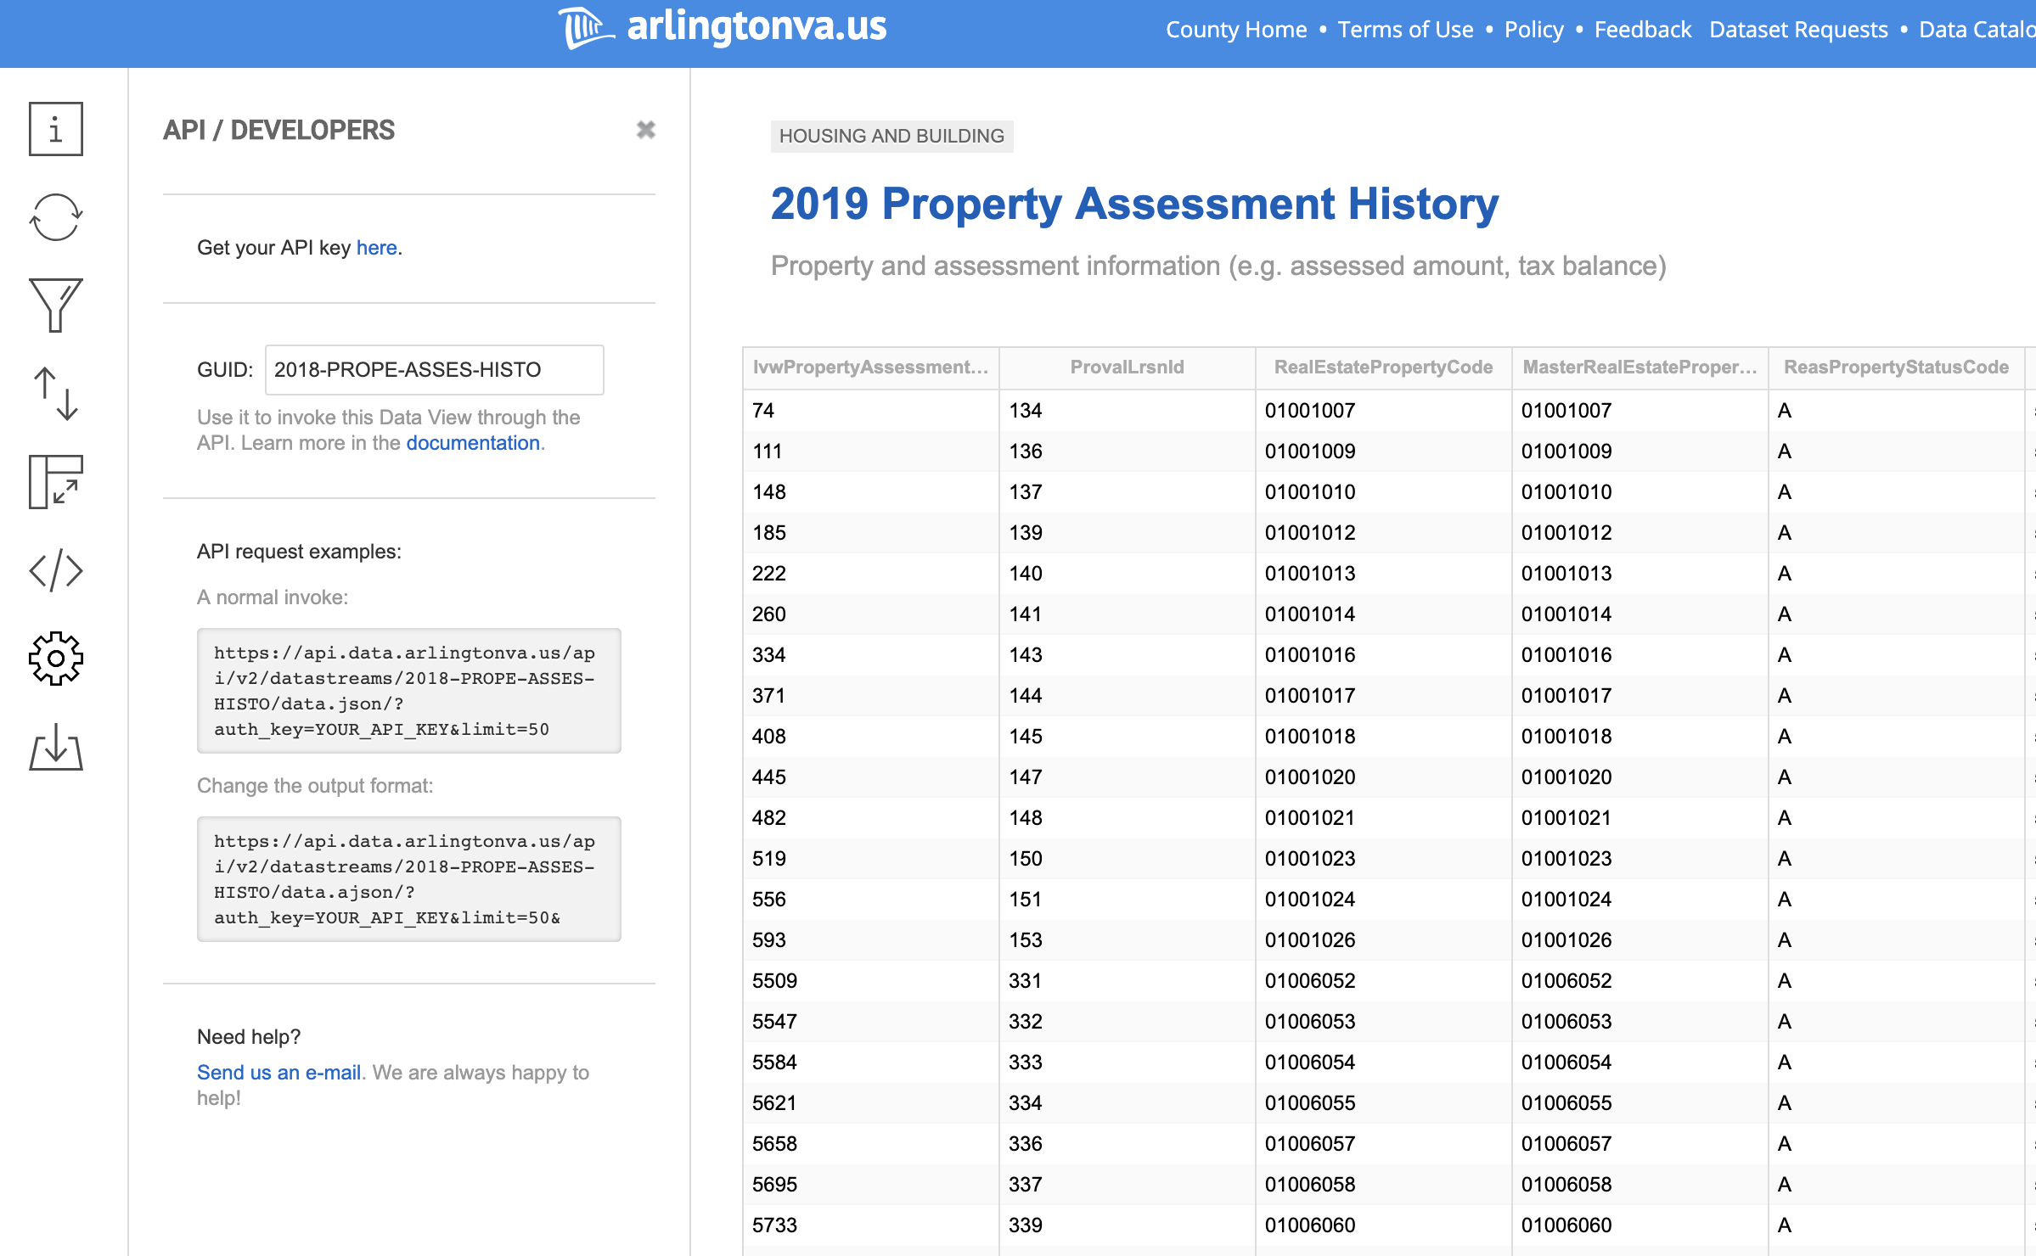
Data Ingestion APIs

Slide 8
Ingest Data: Collection, Experiment (oTree)
oTree lets you create:
Controlled behavioral experiments in economics, market research, psychology, and related fields
Multiplayer strategy games, like the prisoner's dilemma, public goods game, and auctions.
Surveys and quizzes, especially those that require customized or dynamic functionality not available with conventional survey software.

Slide 9
Data Information Process & Platform (Lexicon / PostgreSQL)
The Lexicon: an inventory of and history of changes to:
every available data field in every available data source
the structure of their storage
possible values and meanings of the information
possible transformations of each set of field values from one data source to another another data source
methods of data source access
matching algorithms and how they are to be used in conjunction with possible field value transformations
Provides fundamental functions for the operation of the framework and is a requirement that the data information be collected from all partner communities
Enables removal of much complexity required for high quality data linkage
i.e. No enforcing data standardization schemes on data partners

Slide 10
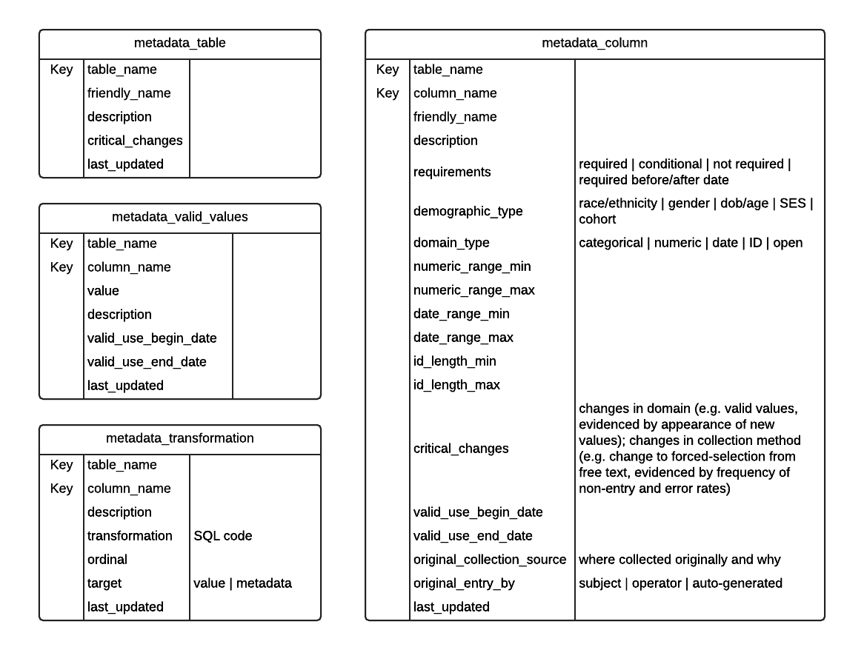
Data Information Process & Platform
Lexicon ER Diagram

Slide 11
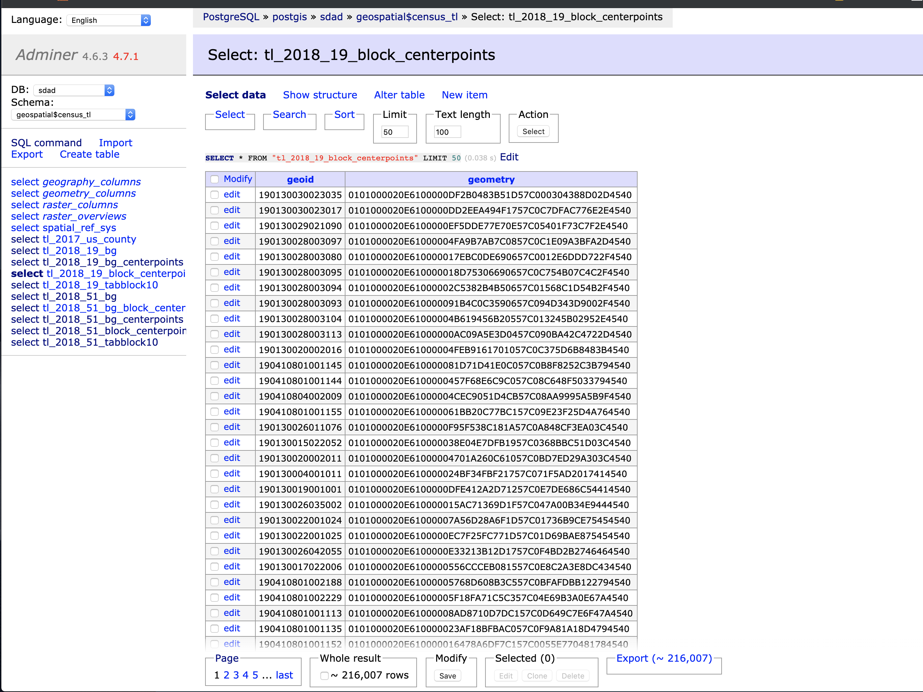
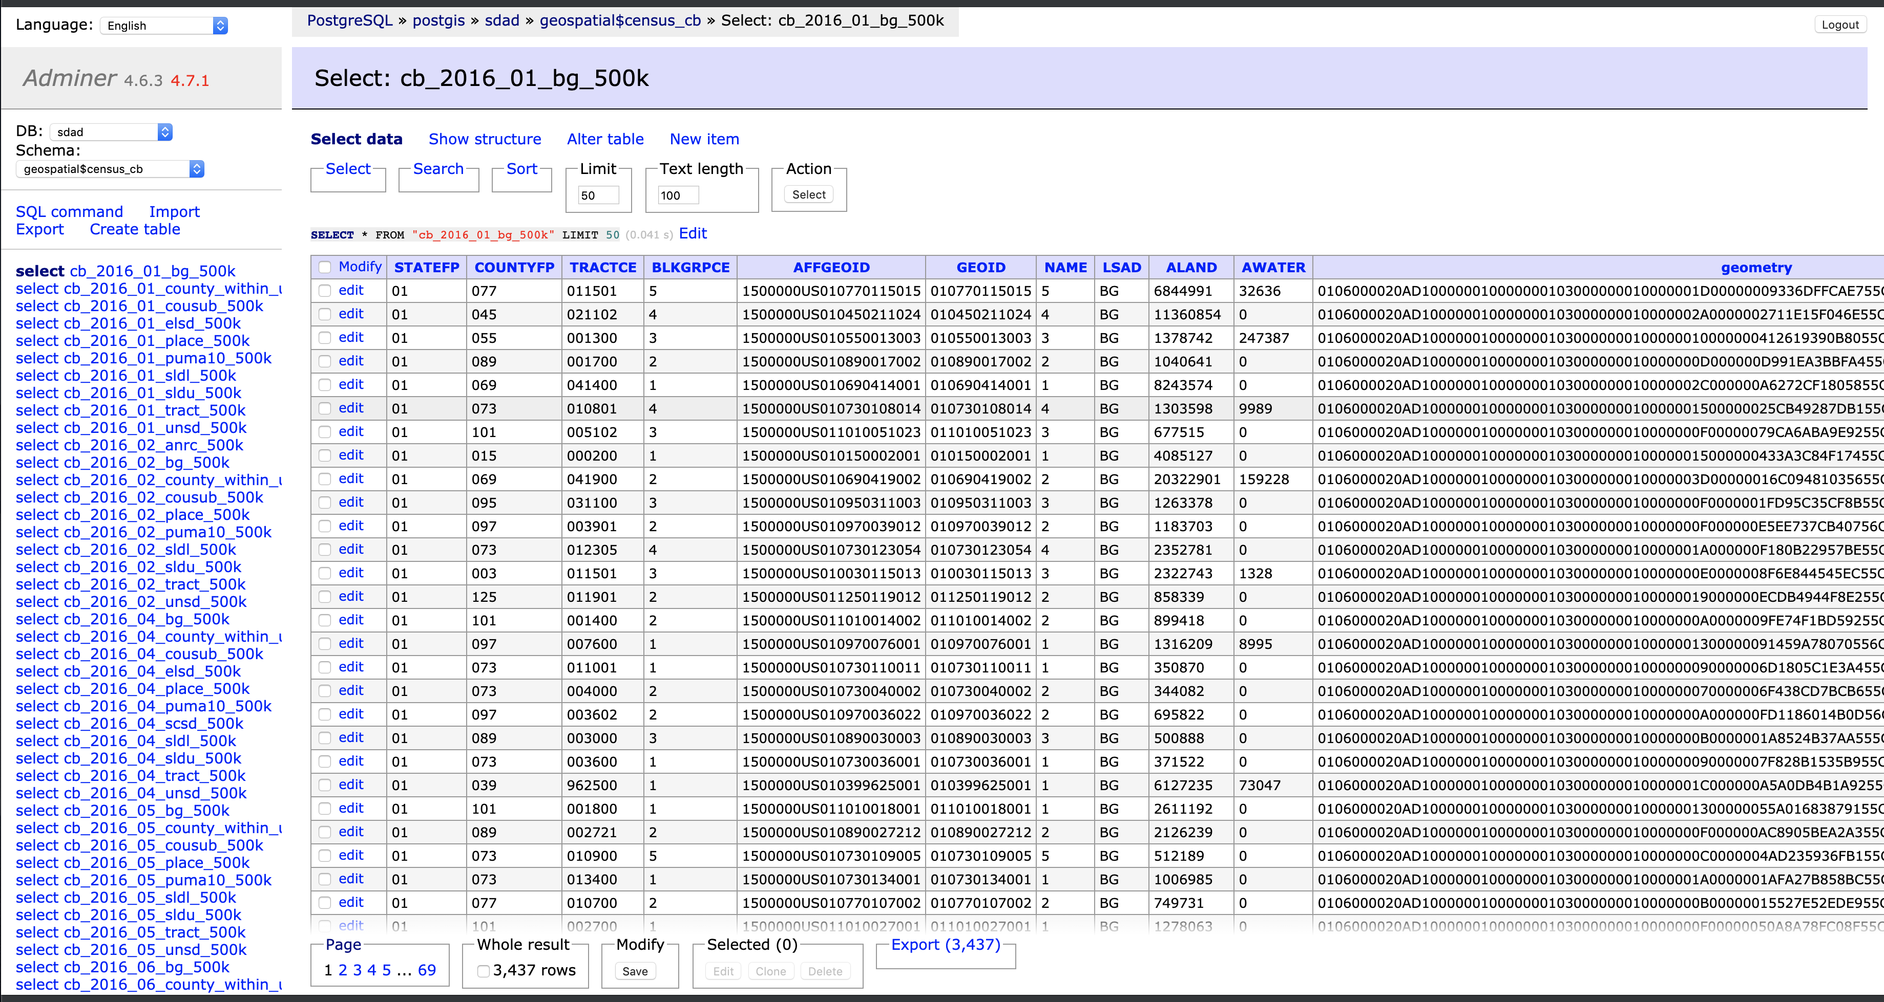
Data Storage and Management Database Choice: PostgreSQL / PostGIS Database Interfaces: Adminer, Rstudio, Jupyter, psql
GIN Indexes + trigrams! ☺
Structured & Unstructured Data
Shape Storage

Slide 12
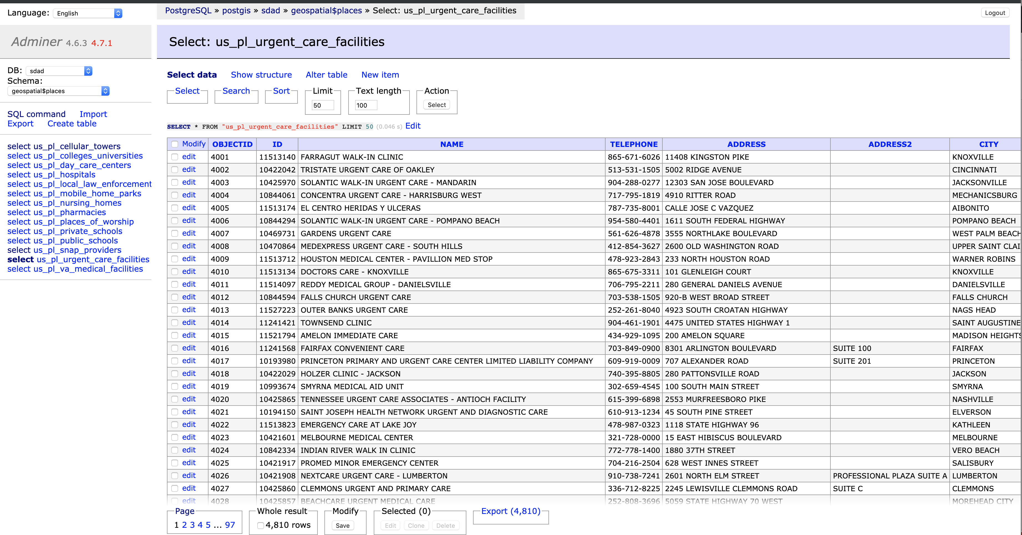
Store most used geographic places

Slide 13
Data Storage and Management Database Choice: PostgreSQL / PostGIS Database Interfaces: Adminer, Rstudio, Jupyter, psql
Very fast access to geo files and database GIS functions
# create db connection
con <- sdalr::con_db(dbname = "sdad", host = "127.0.0.1", port = 5433, user = "anonymous", pass = "anonymous")
# create SQL query
sql <- "SELECT distinct \"GEOID10\" geoid, geometry
FROM tl_2018_19_tabblock10 where left(\"GEOID10\", 5) = '19127’”
# get census blocks
marshall_county_blocks <- sf::st_read(con, query = sql) %>%
st_transform(crs = 4269)

Slide 14
Code Management: GitLab Multiple Branch Management Critical in Team Science

Slide 15
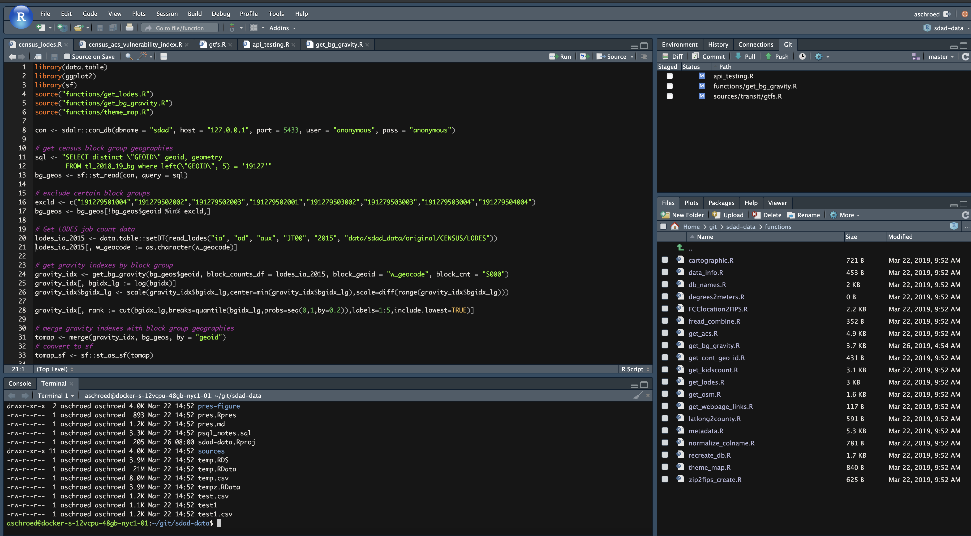
Data Profiling & Preparation Preferred Platform: RStudio Server
Git Integration
Server Files
Command Line (Bash) Access

Slide 16
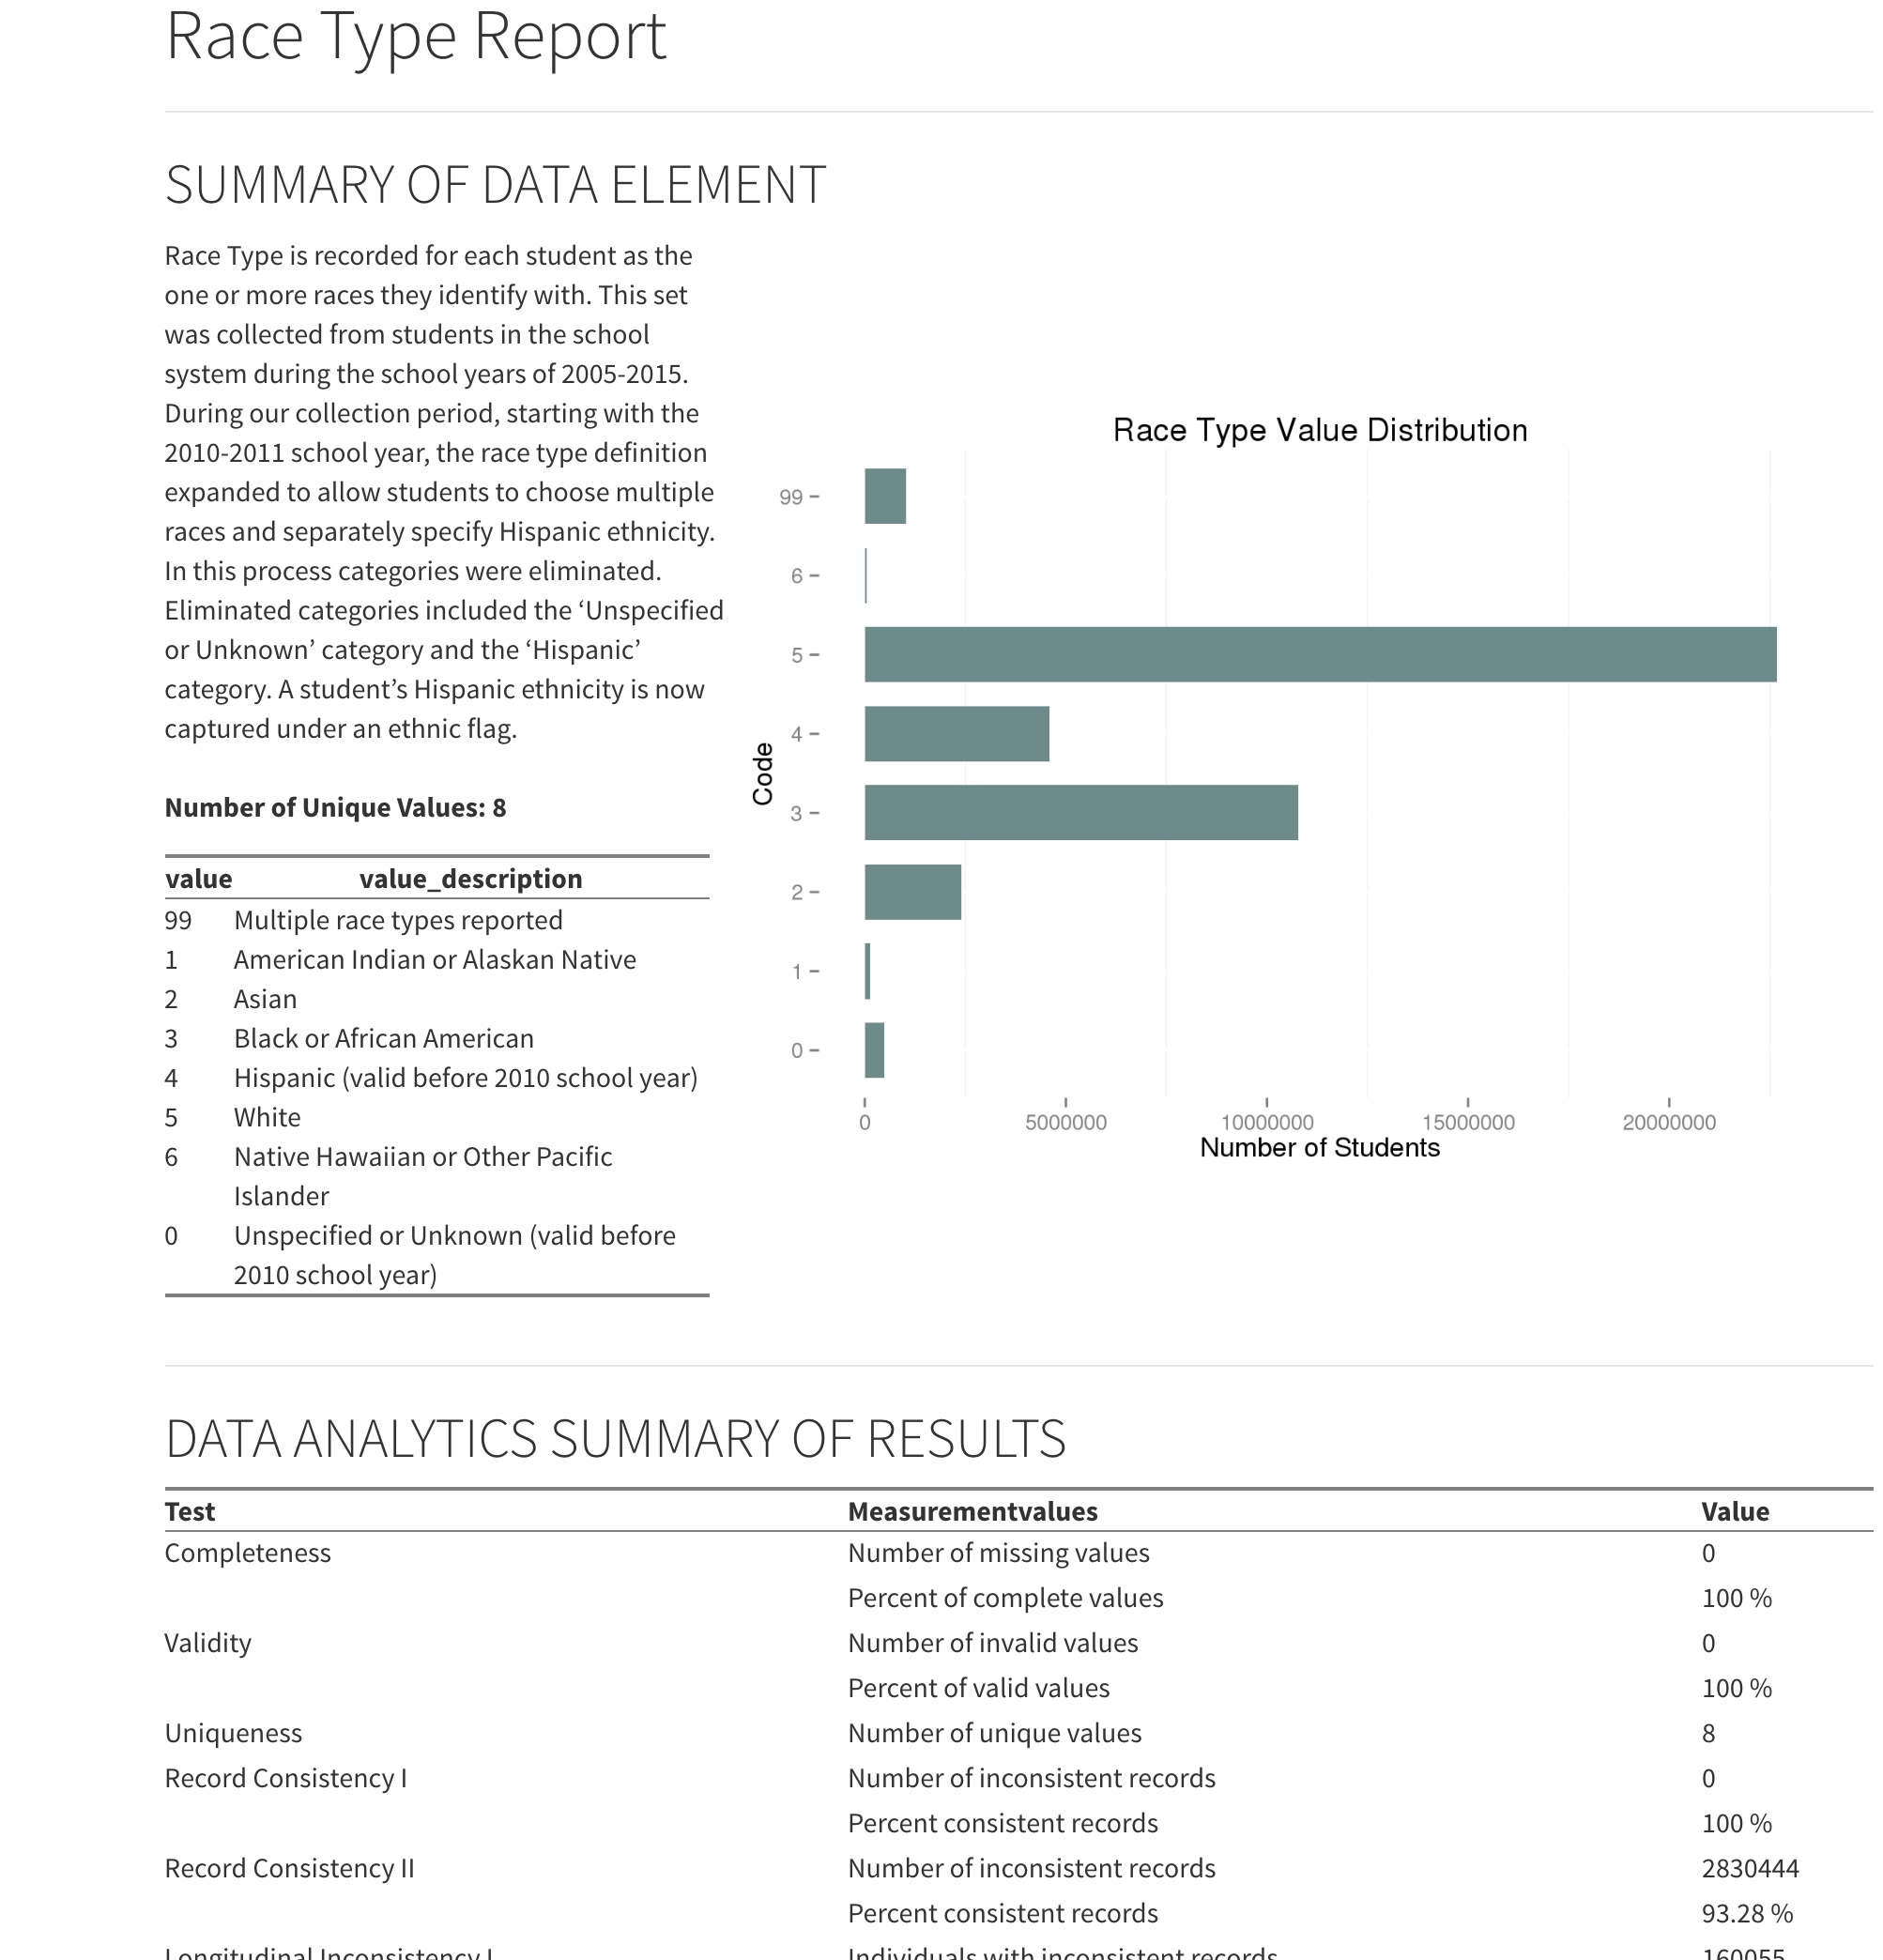
Data Profiling: Quality
Completeness
percentage of elements properly populated
e.g. Testing for NULLs and empty strings where not appropriate
Value Validity
percentage of elements whose attributes possess meaningful values
e.g. A comparison constraint like {male; female} or an interval constraint like age = [0,110]
Consistency
a measure of the degree to which two or more data attributes satisfy a well-defined dependency constraint – relationship validation
e.g. Zip-code – state consistency or gender – pregnancy consistency
Uniqueness
the number of unique values taken by an attribute, or a combination of attributes in a dataset
e.g. Frequency distribution of an element
note. The more homogeneous the data values of an element, the less useful the element is for analysis
Duplication
a measure of the degree of replication of distinct observations per observation unit type
e.g. Greater than 1 registration per student per official reporting period
note. Duplication can occur as a result of choice of level of aggregation; for example, aggregating to a single student registration per academic year when registration information is actually collected multiple times per academic year

Slide 17
Data Profiling: Valid Values
Data elements with proper values have value validity
The percentage of data elements whose attributes possess values within the range expected for a legitimate entry is a measure of value validity
Checking for value validity generally comes in the form of straight-forward domain constraint rules
How many entries contain non-valid values for a non-empty text field representing gender?
< count gender where gender is not (male, female) >
How many entries contain non-valid values for a non-empty integer field representing age?
< count age where age is not between [0, 110] >
Pulled from current James City County MLS Data
zip_code | area | subdivision | neighborhood | zoning | parcel_id
23185 | JCC | Governors Land | River Reach | R-4 | 4511000022
23188 | JCC | Wellington |  | RESIDENT | 1330800178
23188 | JCC | Powhatan Secondary |  | RES | 3741600013
23185 | JCC | Kingsmill | Padgetts Ordinary | R 4 | 5041100213
23185 | JCC | Pointe @ Jamestown |  | RES | 4640600108
23185 | JCC | Paddock Green | Paddock Green | R1
Comparison constraint: zoning 2015, James City County= {A-1, R-1, R-2, R-3, R-4, R-5, R-6, R-7, R-8, LB, B-1, M-1, M-2, RT, PUD, MU, PL, EO}
During Data Profiling issues are described, not “fixed”
The appropriate fix depends upon the needs of the research
It may be appropriate to simply normalize all zoning entries to the five major categories of zoning: Residential, Mixed Residential-Commercial, Commercial, Industrial, and Special

Slide 18
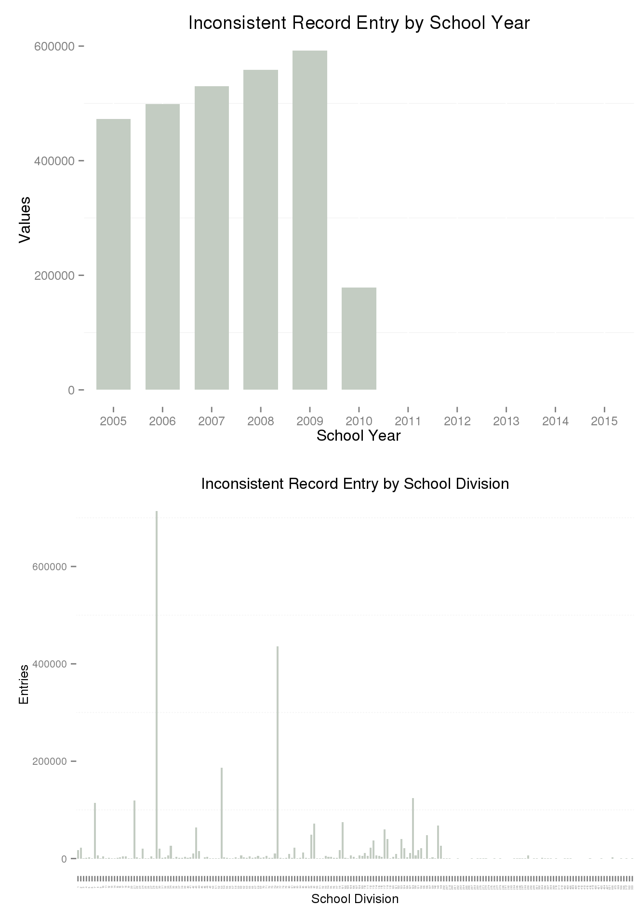
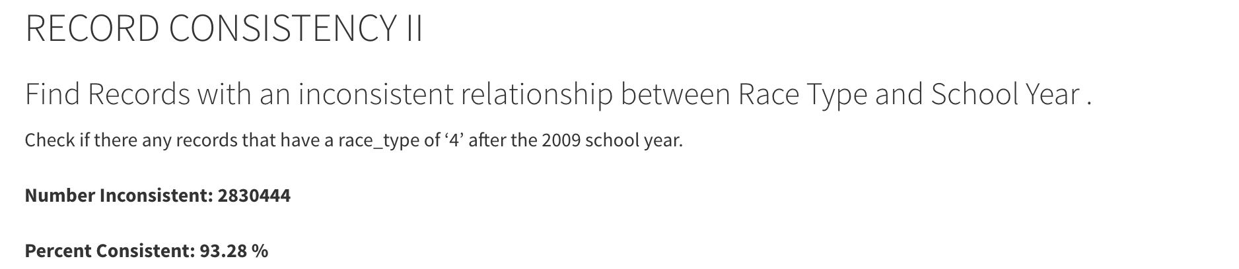
Data Profiling: Consistency
Record Consistency The concept of record consistency is best understood as the degree of logical agreement “between” record field values in either a single dataset or between two or more datasets. Simple Example: location disagreement between zip code and state FIPS code.
Longitudinal Consistency An inconsistency in the data when checked over time (longitudinally), to see if the same value is recorded for every new record when it should be (i.e. birthdate and other demographics).

Slide 19
Data Profiling & Preparation
Current Structure of Williamsburg MLS Data
List Number |  | Agency Name | Agency Phone | Agency Email | Listing Agent | Listing Agent Phone | Listing Agent Email | Co-Listing Agent | Property Type | Card Format
 | Book Section | Selling Agency | Selling Agency Phone | Selling Agency Email | Selling Agent | Selling Agent Phone | Selling Agent Email | Co-Selling Agent | End Date | book_sec
 | Listing Date | Sold Date | Under Cont. Date | Fall-thru Date | Status | Status Change | Withdraw Date | Cancel Date | Contingent | Cont. Remarks
 | Orig. List Price | Price | Sold Price | high_price | Low Price | assessed_val | Partial Tax Assmnt | financing | Area | Relocation
 | St. # | box_nbr | St. Dir. | Street Name | Address 2 | streetdirsuffix | Street Suffix | carrier_route | City | State
 | county | country | Zip Code | geo_county | Taxes | geo_lat | geo_lon | Est. Fin. SqFt | sqft1 | sqft2
 | sqft3 | sqft4 | Year Built | 2+ Bdroms on 1st Flr | Realtor.com Type | lot_size | Total Acres | Condo Level | sell_broker_comm | Variable Commission
 | stories | Total Rooms | Total Bedrooms | total_bath | Baths - Full | Baths - Half | baths_3_4 | Garage Type | garage_stall | Water Frontage
 | Zoning | taxes | Tax Year | Subdivision | Public Remarks | Agent Remarks | Parcel ID | Legal Description | Directions | Foreclosure
 | Owner Phone | Owner Name | Neighborhood | mod_timestamp | Ltd Service Agent | Occupied By | Owner/Agent | Mster Bdrm 1st Floor | SqFt Source | Listing Type
 | # Stories | # Fireplaces | Golf Frontage | IDX Y/N | Supplement Attached | Seller Concession(s) | Special Assmnts | Type | Rollback Taxes | userdefined16
 | SellingBroker Incent | Ownership | Describe Concession | How Sold | Selling Broker Comp | userdefined22 | Assessed Value | Est.Unfinished Sq Ft | Tax Rate | Garage Bays
 | userdefined27 | userdefined28 | userdefined29 | userdefined30 | Est. Closing Date | userdefined32 | userdefined33 | Lot Description | Short/CompromiseSale | userdefined36
 | userdefined37 | userdefined38 | userdefined39 | userdefined40 | userdefined41 | userdefined42 | userdefined43 | userdefined44 | userdefined45 | userdefined46
 | userdefined47 | userdefined48 | userdefined49 | userdefined50 | userdefined51 | userdefined52 | userdefined53 | userdefined54 | userdefined55 | userdefined56
 | Photo URL | Days on Market | Rooms | Features
The Data Preparation Phase includes the activities necessary to “fix” the issues of Quality, Structure, and Metadata discovered during Data Profiling – activities can include:
Cleansing
Missing Values
Date Formats
Nominal => numeric
Outliers
Inconsistent Data
De-duplication
Transformation
Aggregation
Normalization
Smoothing/Winsorization
Imputation
Feature Construction
Restructuring
Ideal Restructuring of MLS Data
Property Characteristics
∞
Property ID
&
Location
Property Sales Information
1
∞
Property Tax Information
∞

Slide 20
Recent Example: Distinct Counts of Children 0-5 Datasets Under Consideration Finding the best representations of Who, What, When & Where Across Agencies, Across Datasets

Slide 21
Recent Example: Distinct Counts of Children 0-5 Longitudinal Consistency
Each dataset profiled to discover the most consistent recording of demographic information over time

Slide 22
Recent Example: Distinct Counts of Children 0-5 Transformation & Linkage Enables Distinct Count Cross-Tabulation

Slide 23
Recent Example: Distinct Counts of Children 0-5 Distinct Count Cross-Tabulation Enables Distinct Count Plots

Slide 24
Recent Example: Distinct Counts of Children 0-5 Distinct Count Cross-Tabulation Enables Creation of New Indices
Example Composite Index Combining SNAP (Nutrition) and OCS (Behavioral Assistance) Data

Slide 25
Data Analysis & Data Product Creation Preferred Platform: RStudio Server
Git Integration
Server Files
Command Line (Bash) Access

Slide 26
Data Ingestion Marshalltown
Shapefiles from our GIS database (PostGIS)
# create db connection
con <- sdalr::con_db(dbname = "sdad", host = "127.0.0.1", port = 5433, user = "anonymous", pass = "anonymous")
# create SQL query
sql <- "SELECT distinct \"GEOID10\" geoid, geometry
FROM tl_2018_19_tabblock10 where left(\"GEOID10\", 5) = '19127’”
# get census blocks
marshall_county_blocks <- sf::st_read(con, query = sql) %>%
st_transform(crs = 4269)

Slide 27
Data Ingestion Marshalltown
library(tidytransit)
# get Marshalltown feed URL
feed_url <- feedlist_df %>%
setDT(.) %>%
.[loc_t %like% "Marshalltown, IA", url_i]
# read gtfs data from url
gtfs <- read_gtfs(feed_url, geometry = TRUE, frequency = TRUE)
Transit route data from transitfeeds.com

Slide 28
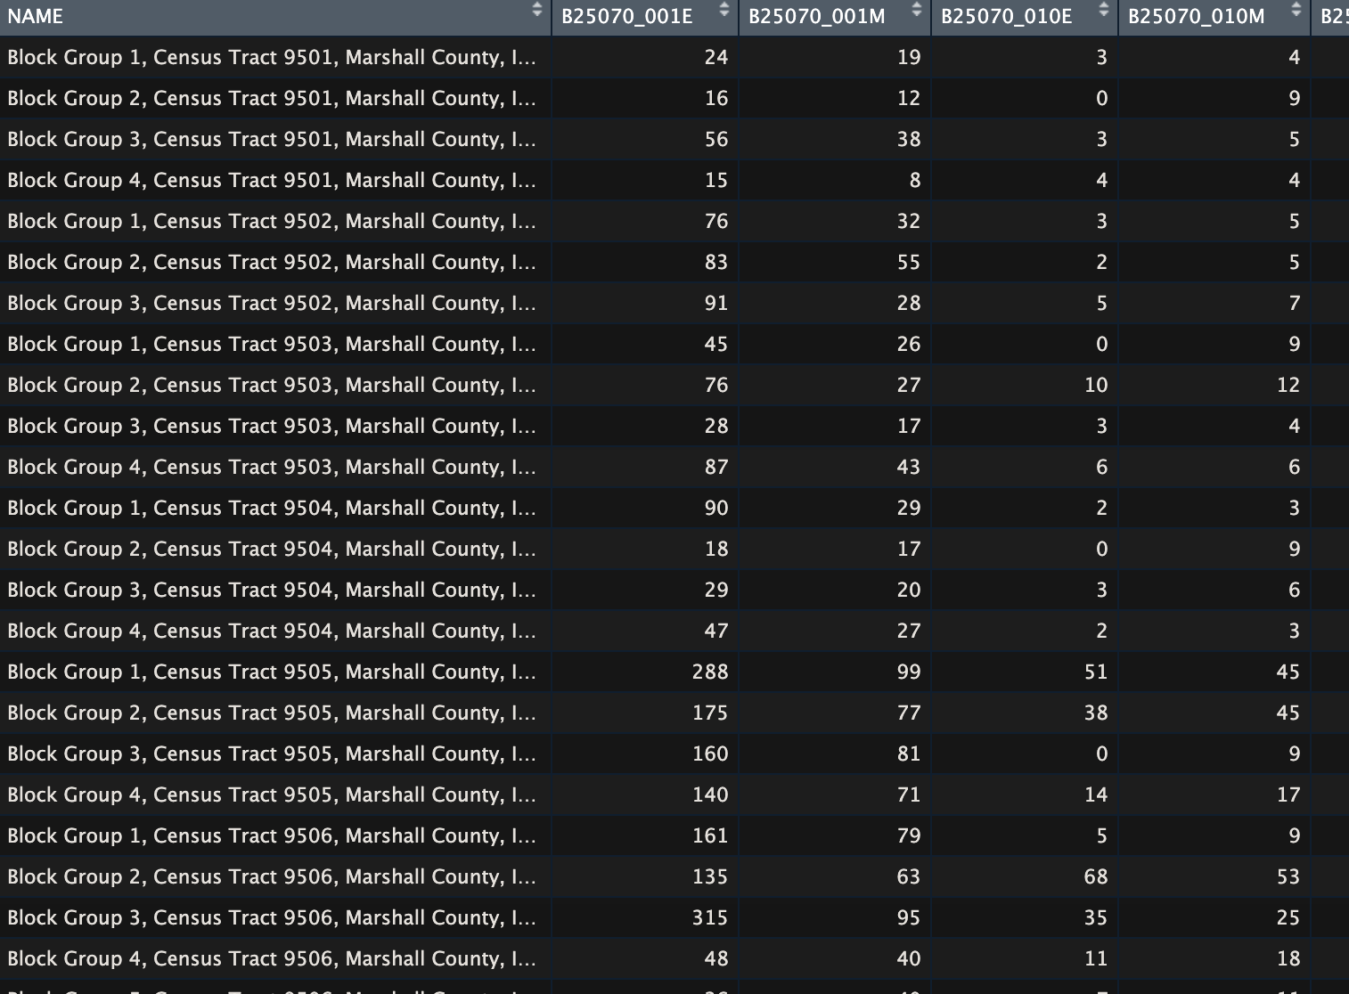
Data Ingestion Marshalltown
acs_vars <- c(
"B25070_001","B25070_010",
"B25091_001","B25091_011","B25091_022",
"B25044_001","B25044_003","B25044_010",
"B22010_001","B22010_002",
"B17021_001","B17021_002"
)
acs_est <- get_acs(geography="block group",state=state_names,county=county_names,
variables=acs_vars,year=year,cache_table=TRUE,output="wide", geometry = TRUE)
Vulnerability data composited from Census ACS housing, transportation, and nutrition subsidy variables

Slide 29
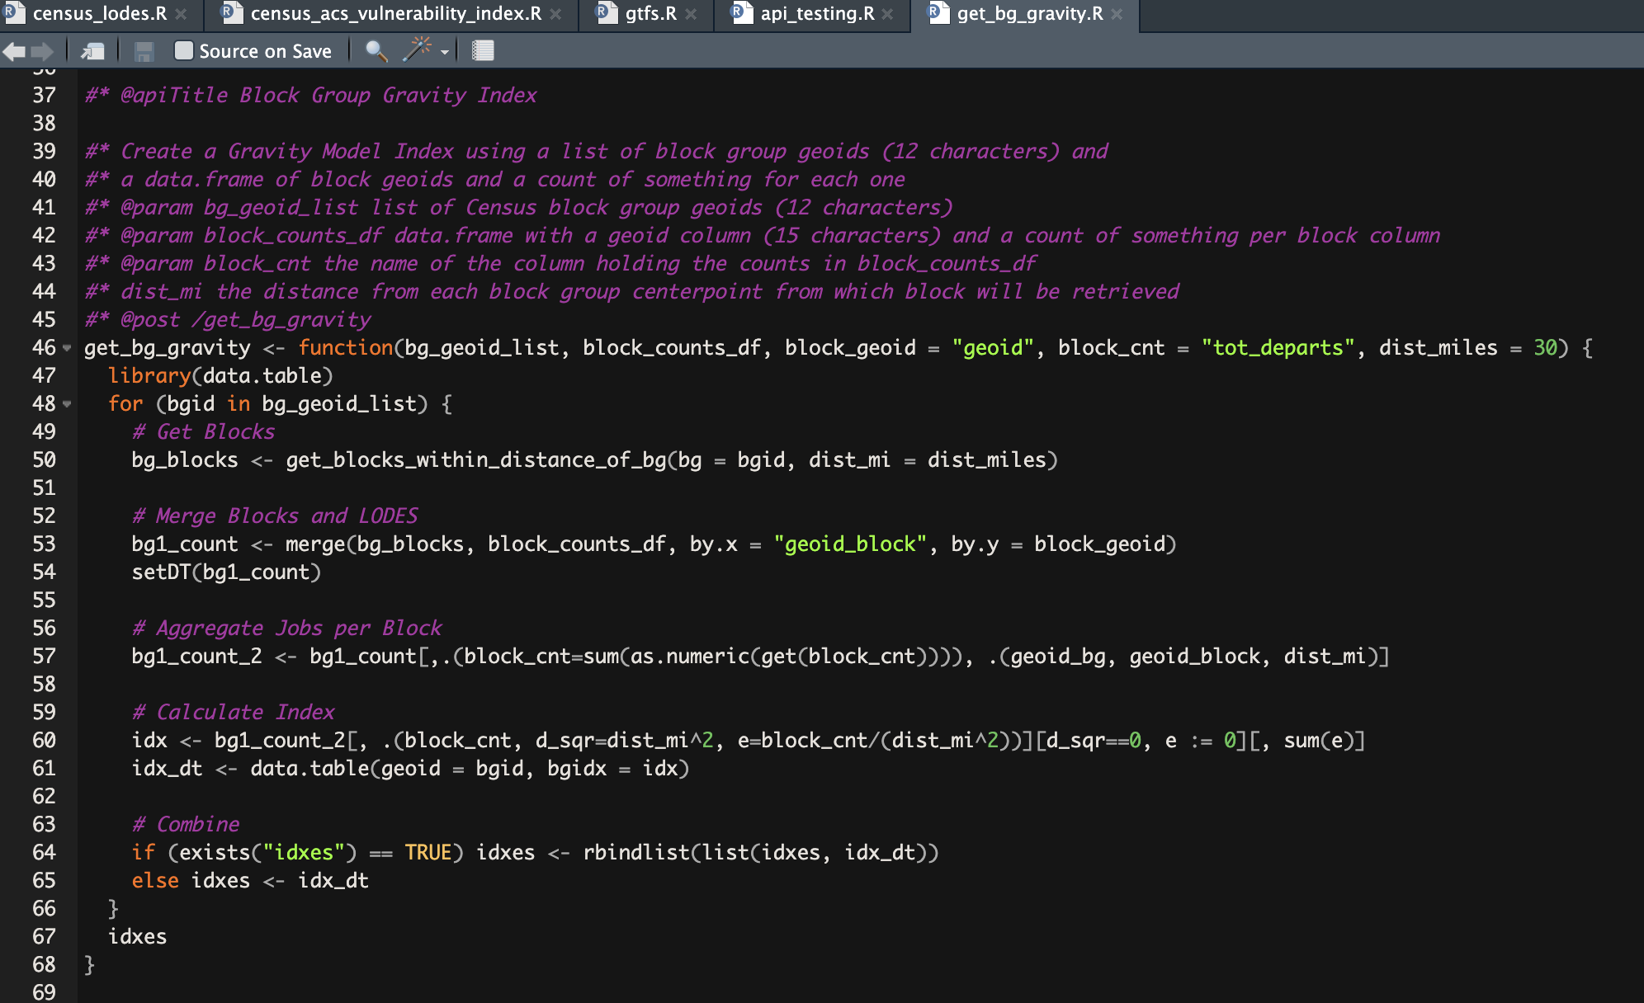
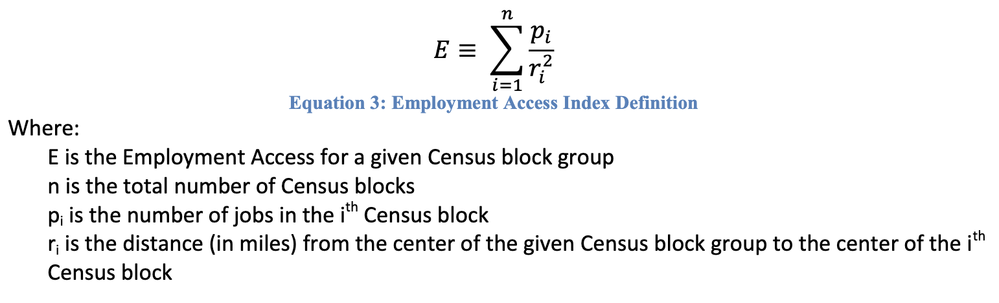
Gravity Models for Job Access and Transit Access

Slide 30
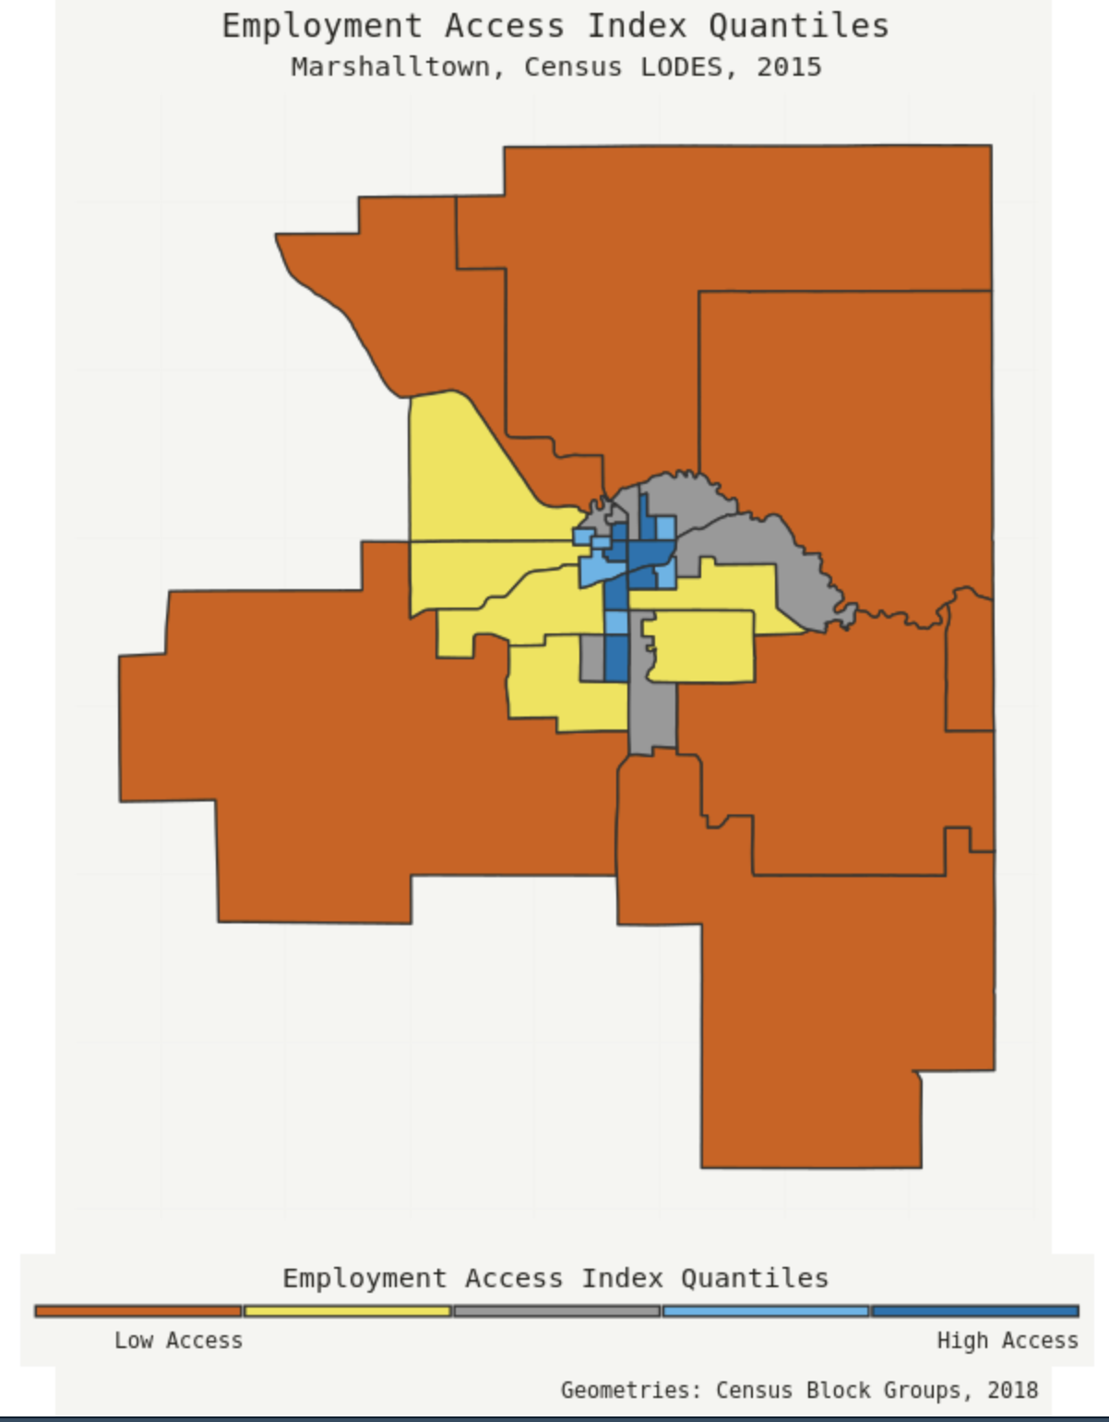
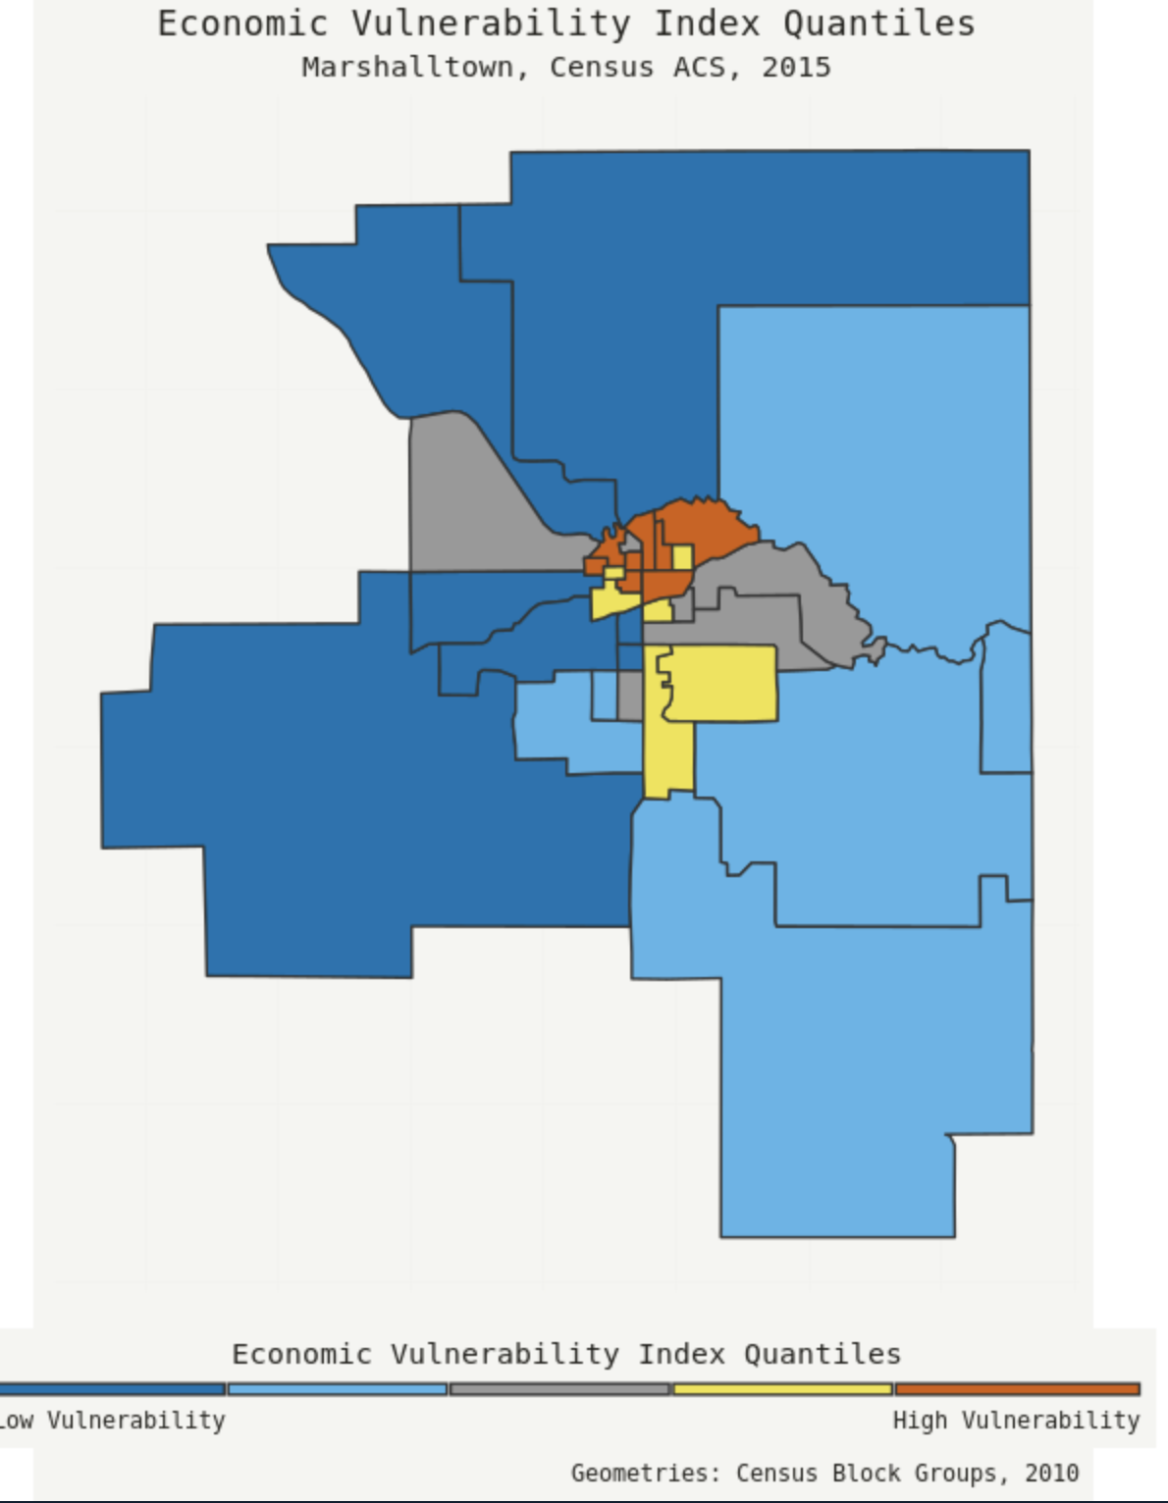
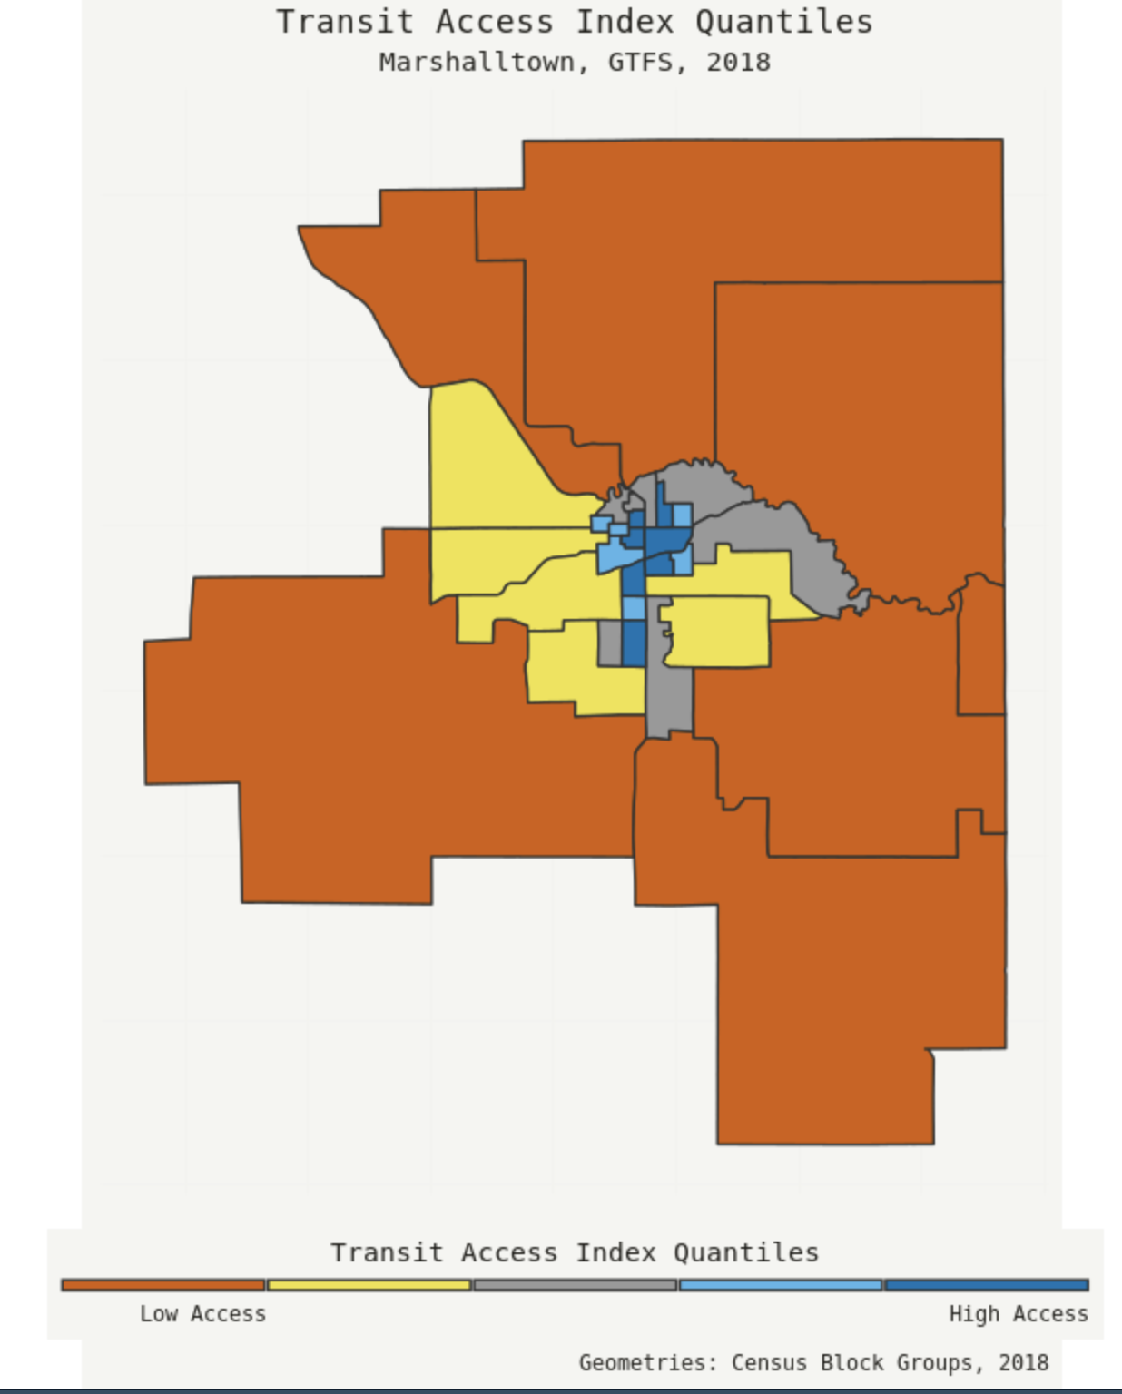
Data Visualization & Sharing: Maps (ggplot) Combining Administrative and Survey Data to Relate Job Availability, Economic Vulnerability and Access to Transit
LEHD Origin-Destination Employment
Statistics (LODES),
American Community Survey (ACS)
General Transit Feed Specification (GTFS)

Slide 31
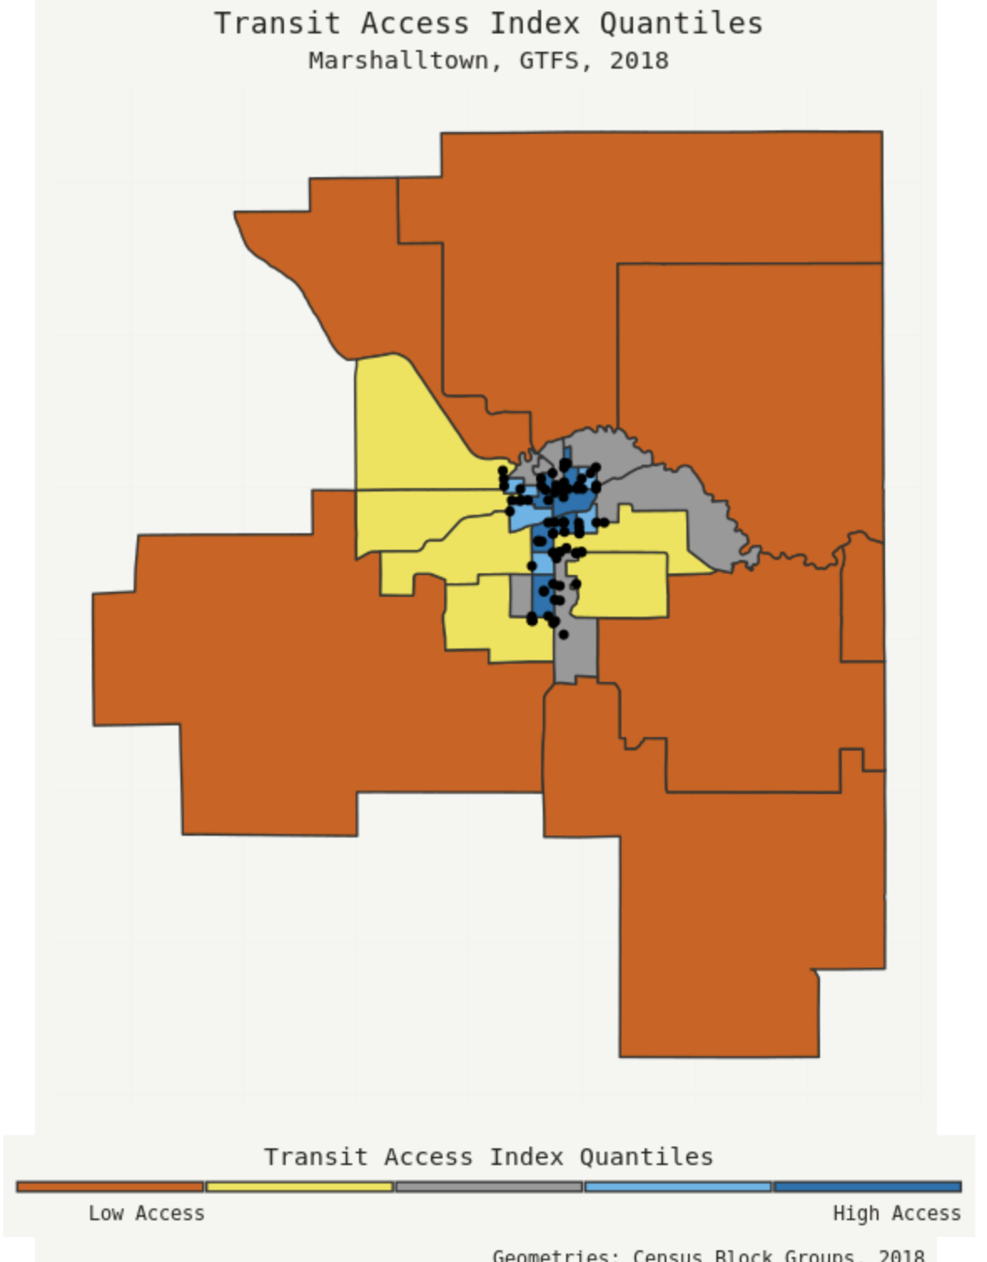

Slide 32
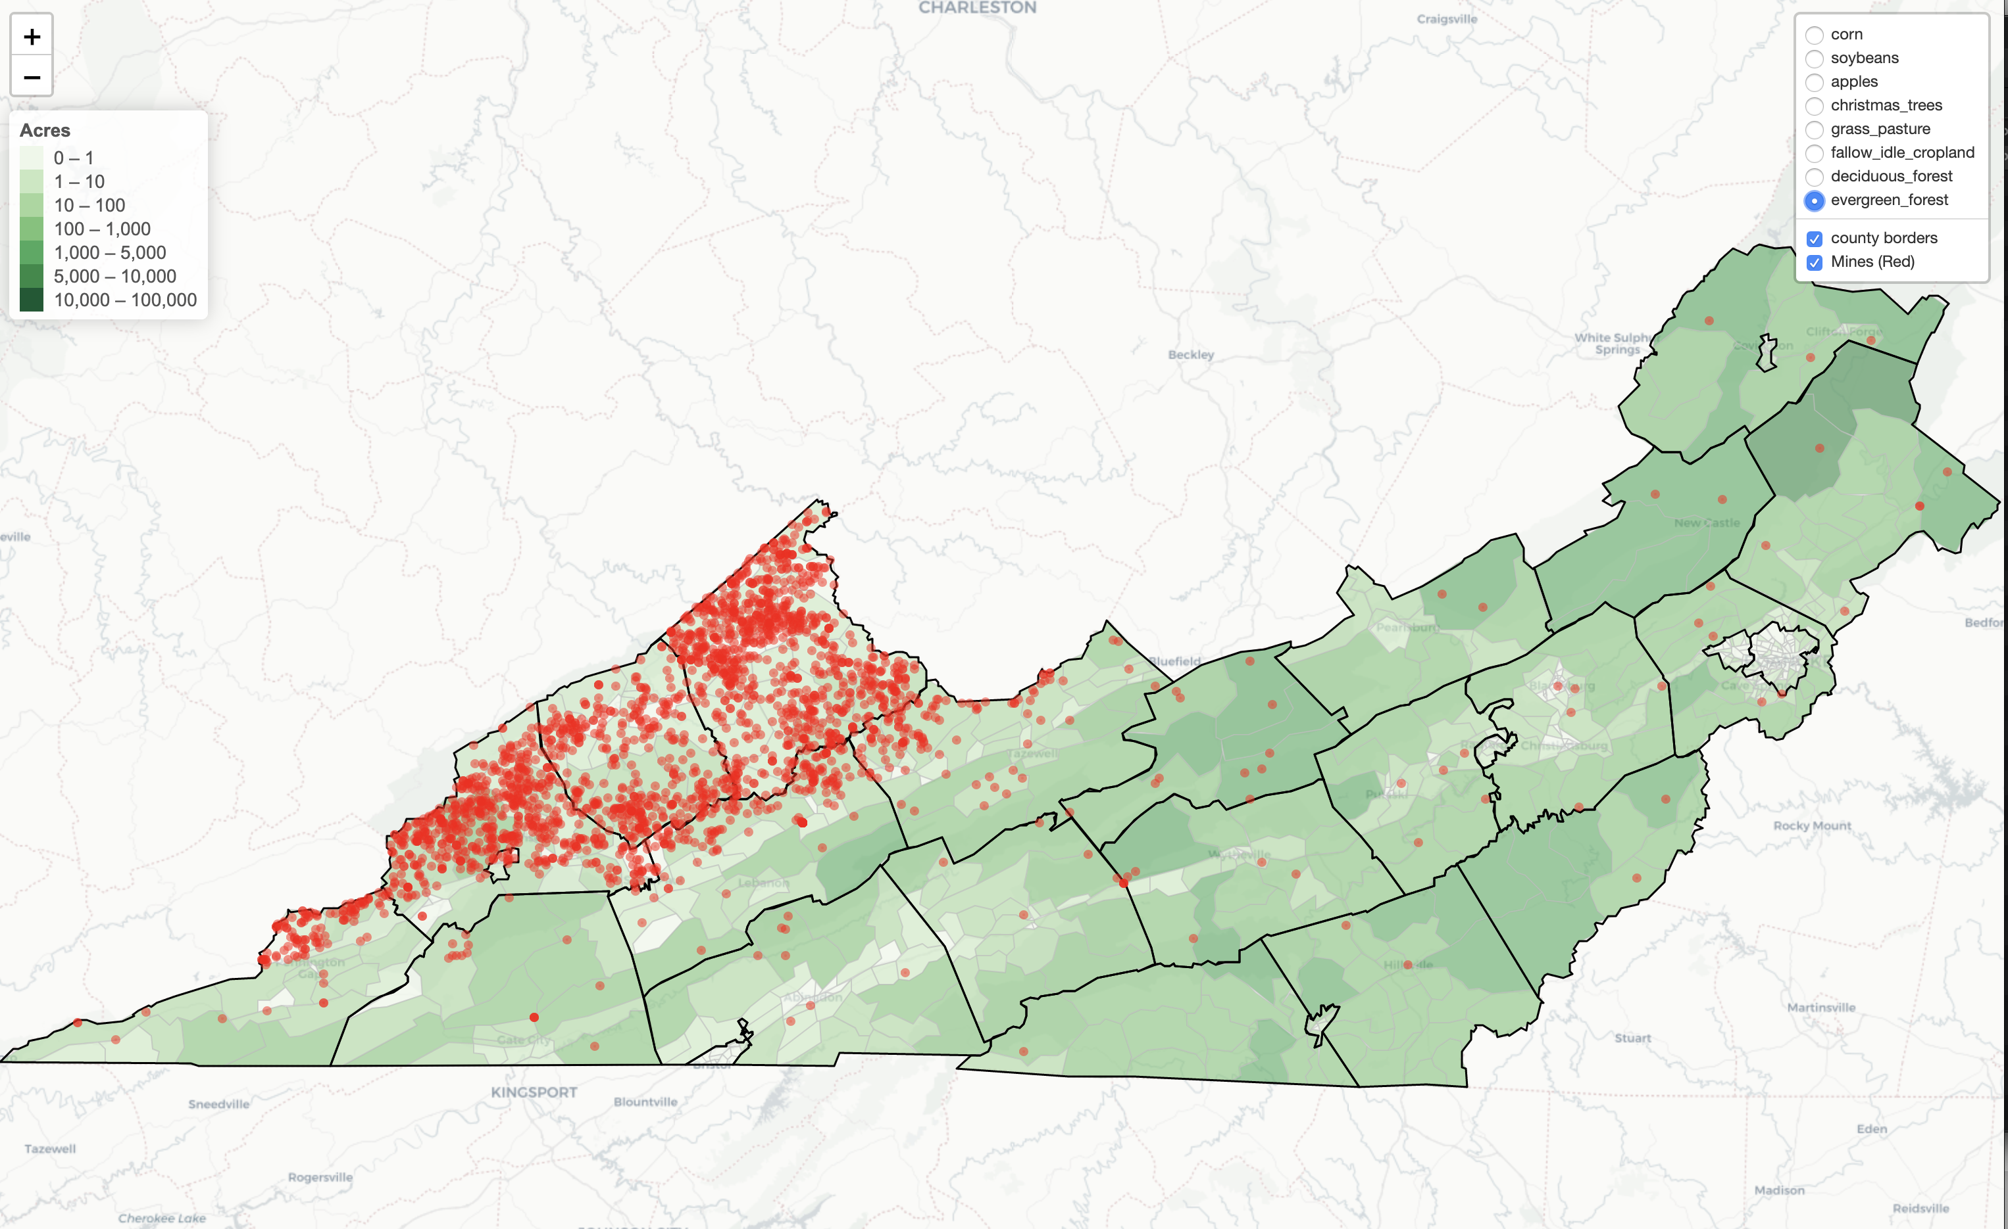
Data Visualization & Sharing Interactive Maps (leaflet)

Slide 33
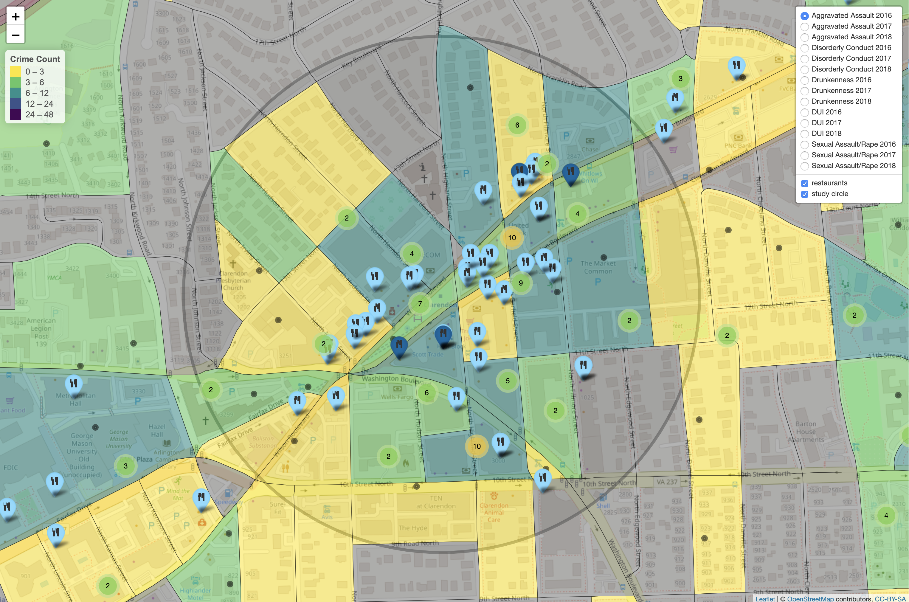
Data Visualization & Sharing Interactive Maps (leaflet)

Slide 34
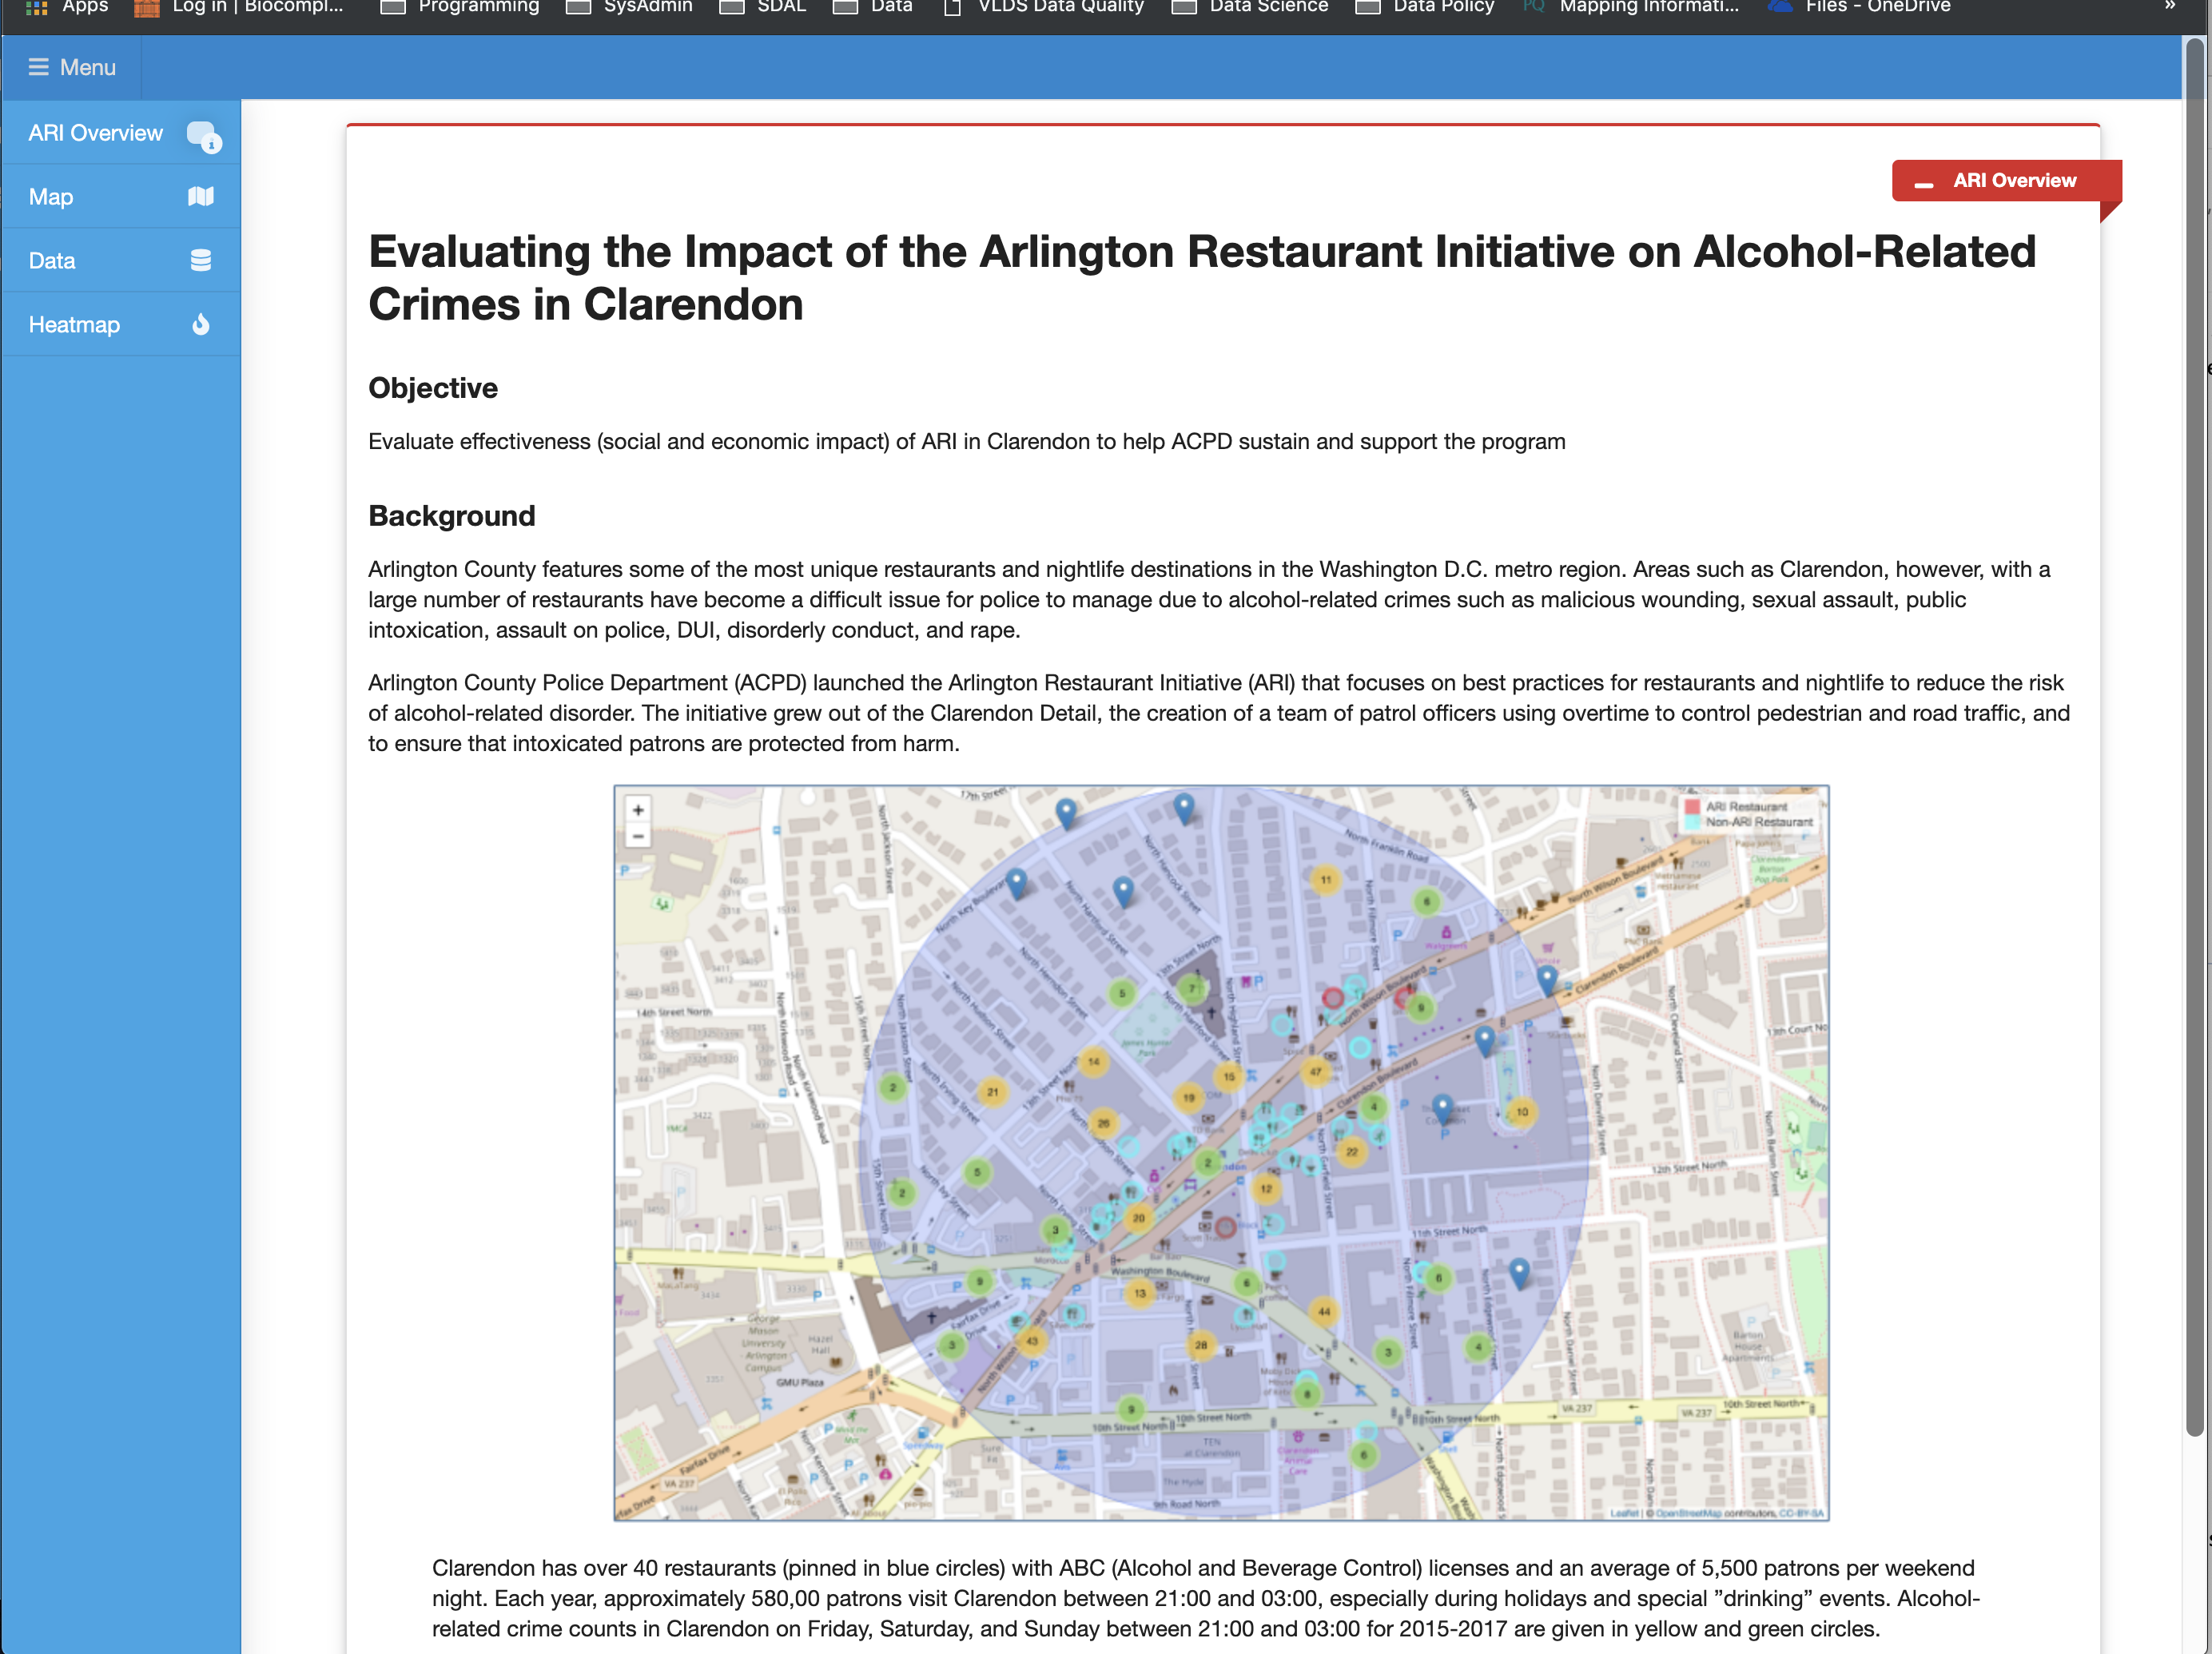
Data Visualization & Sharing Dashboards (R Shiny, Django)

Slide 35
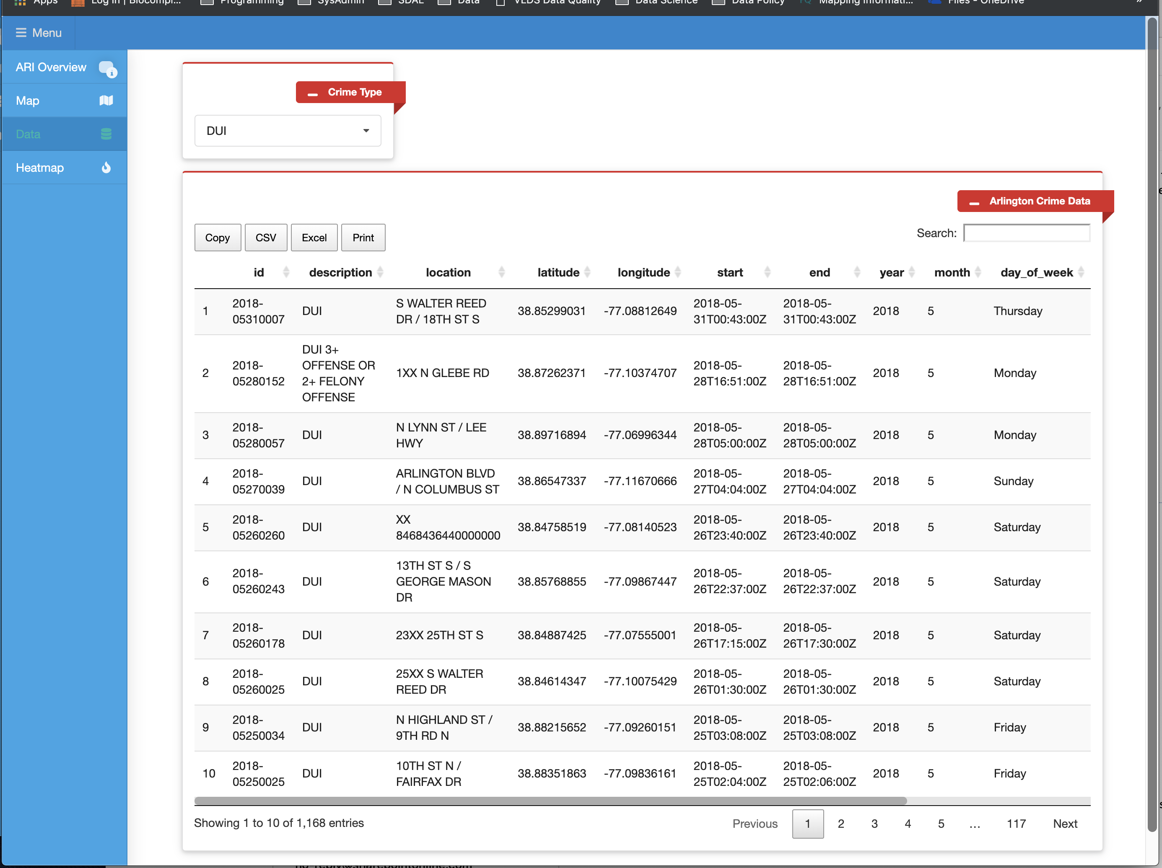

Slide 36
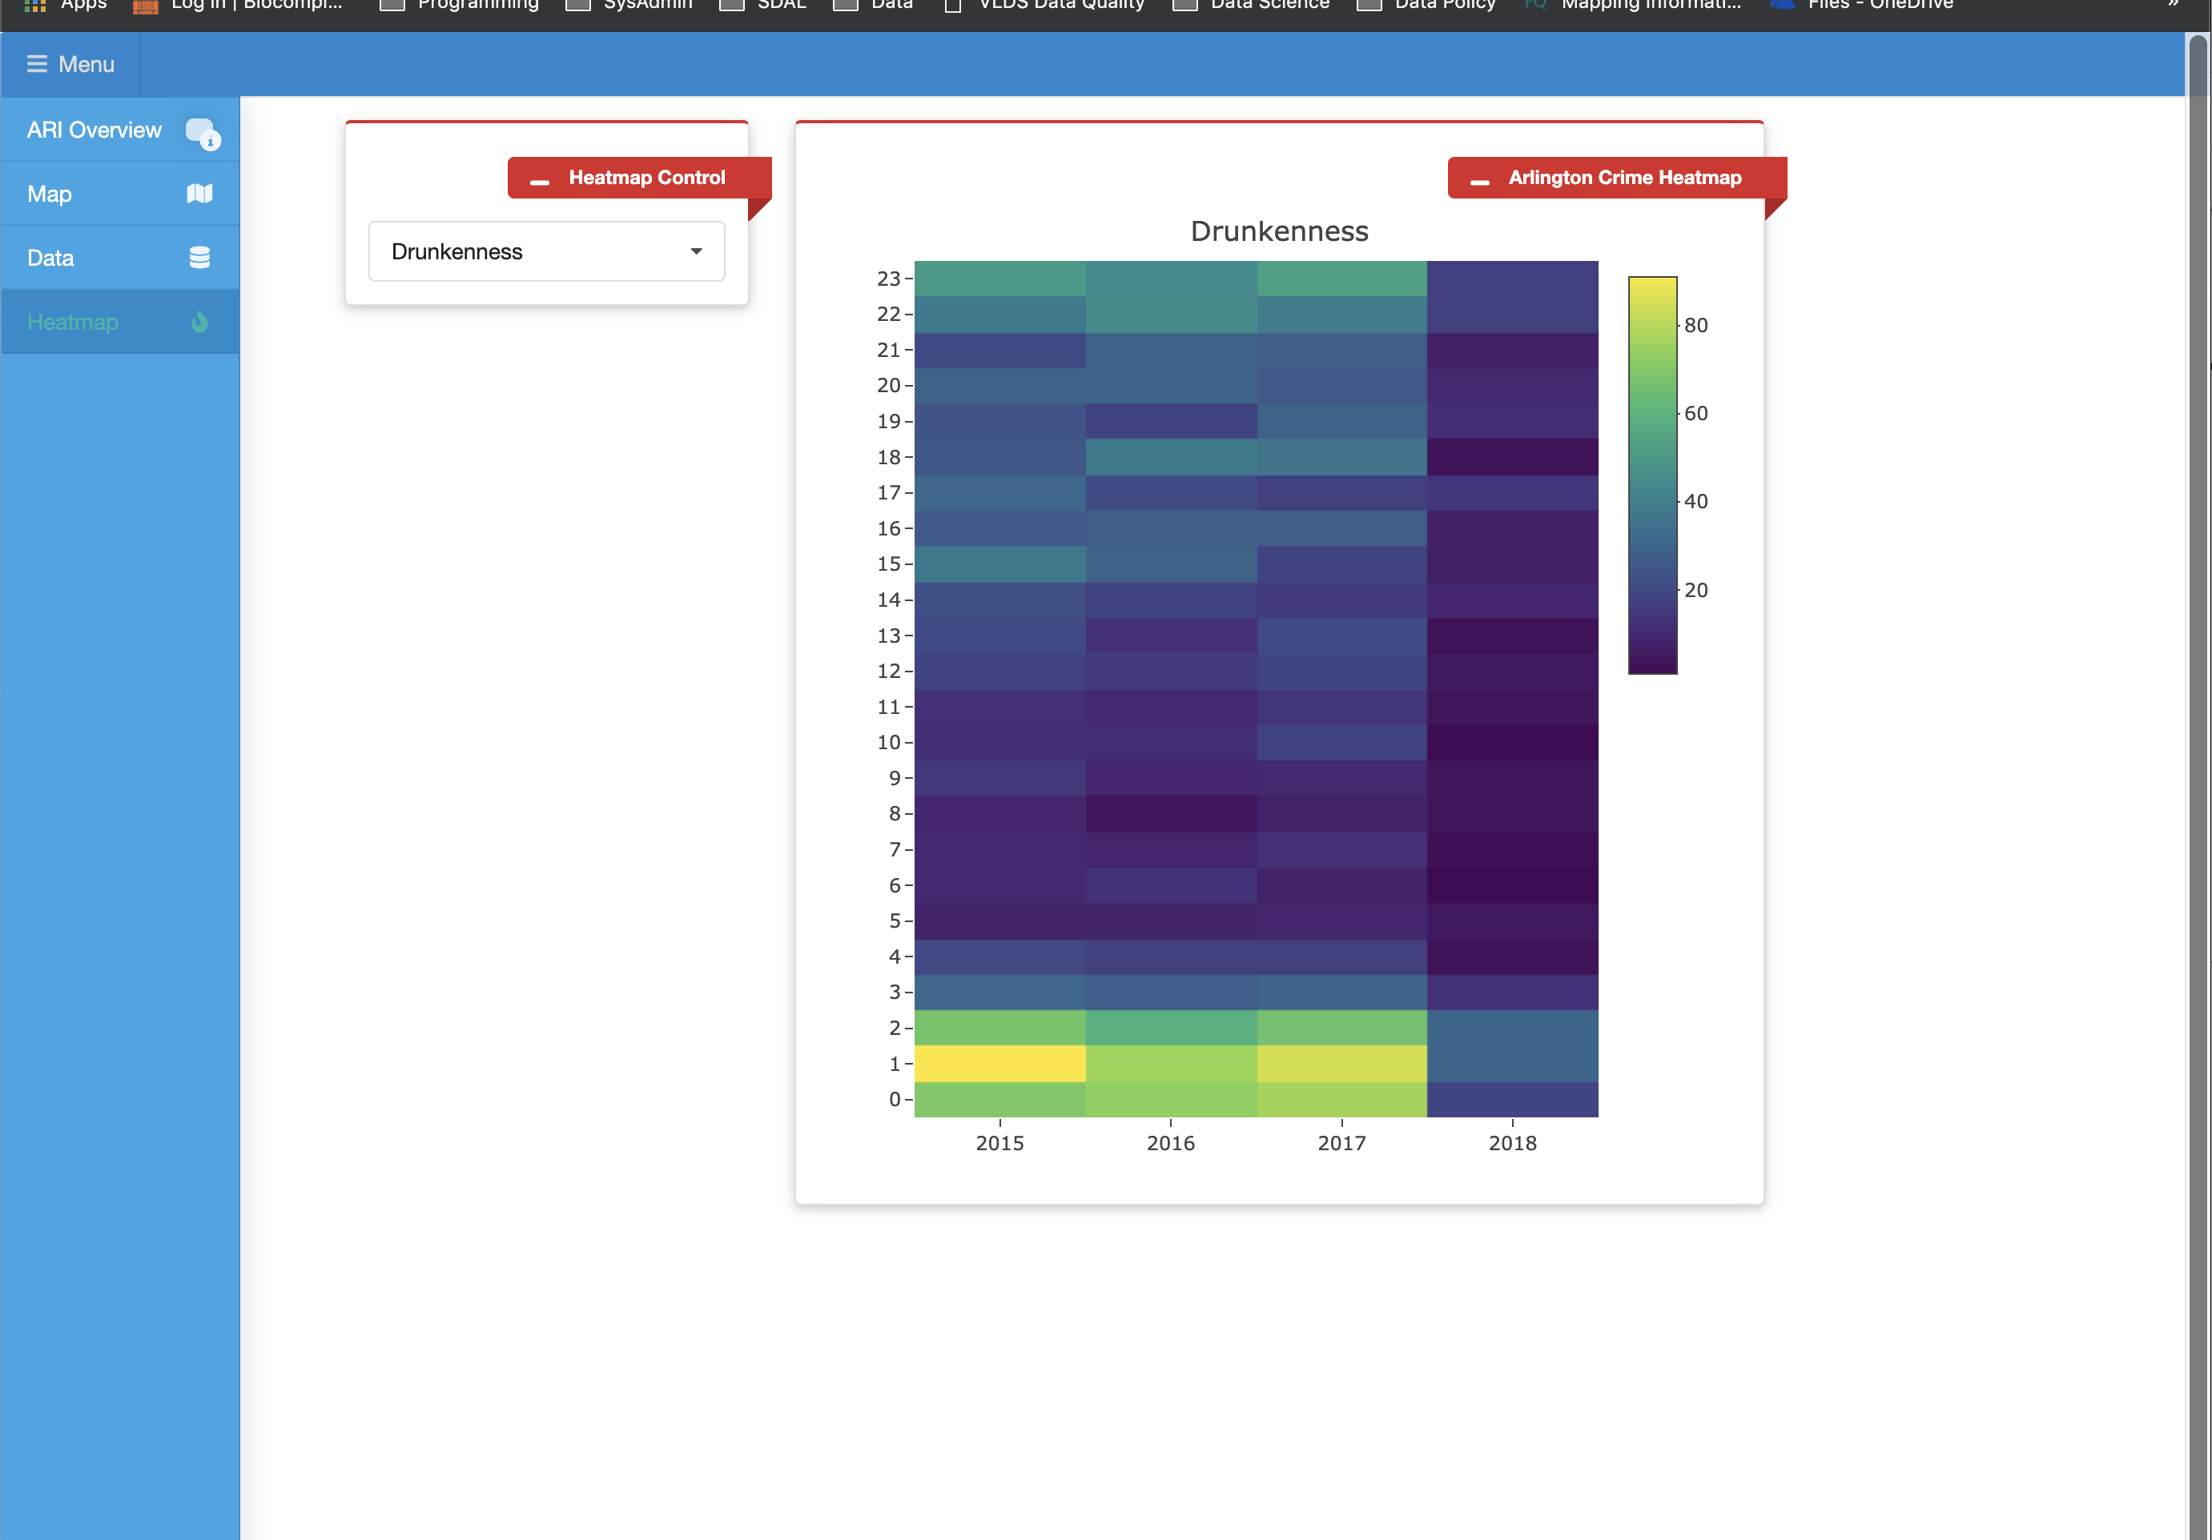

Slide 37
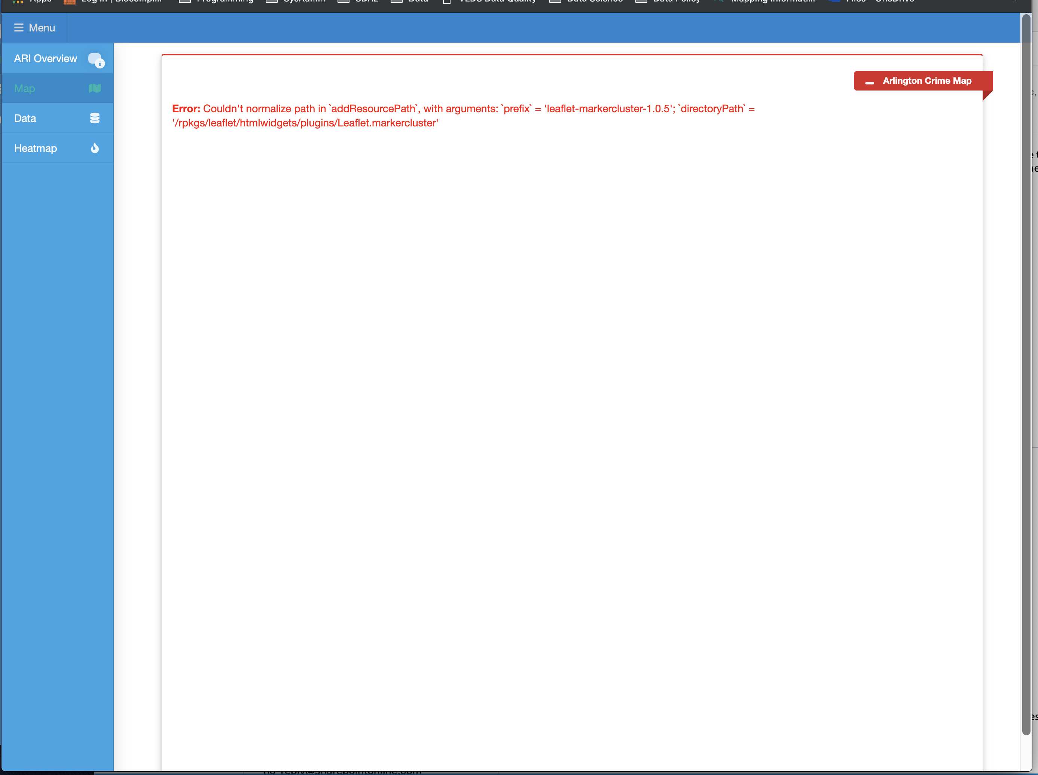
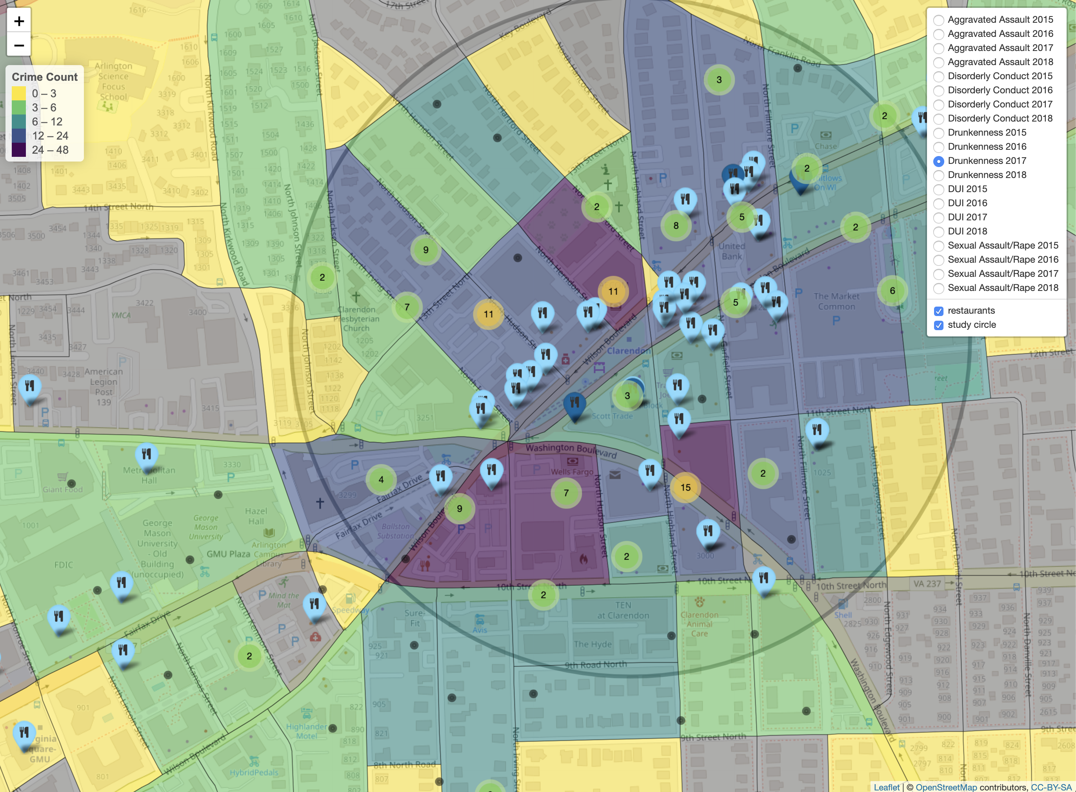

Slide 38
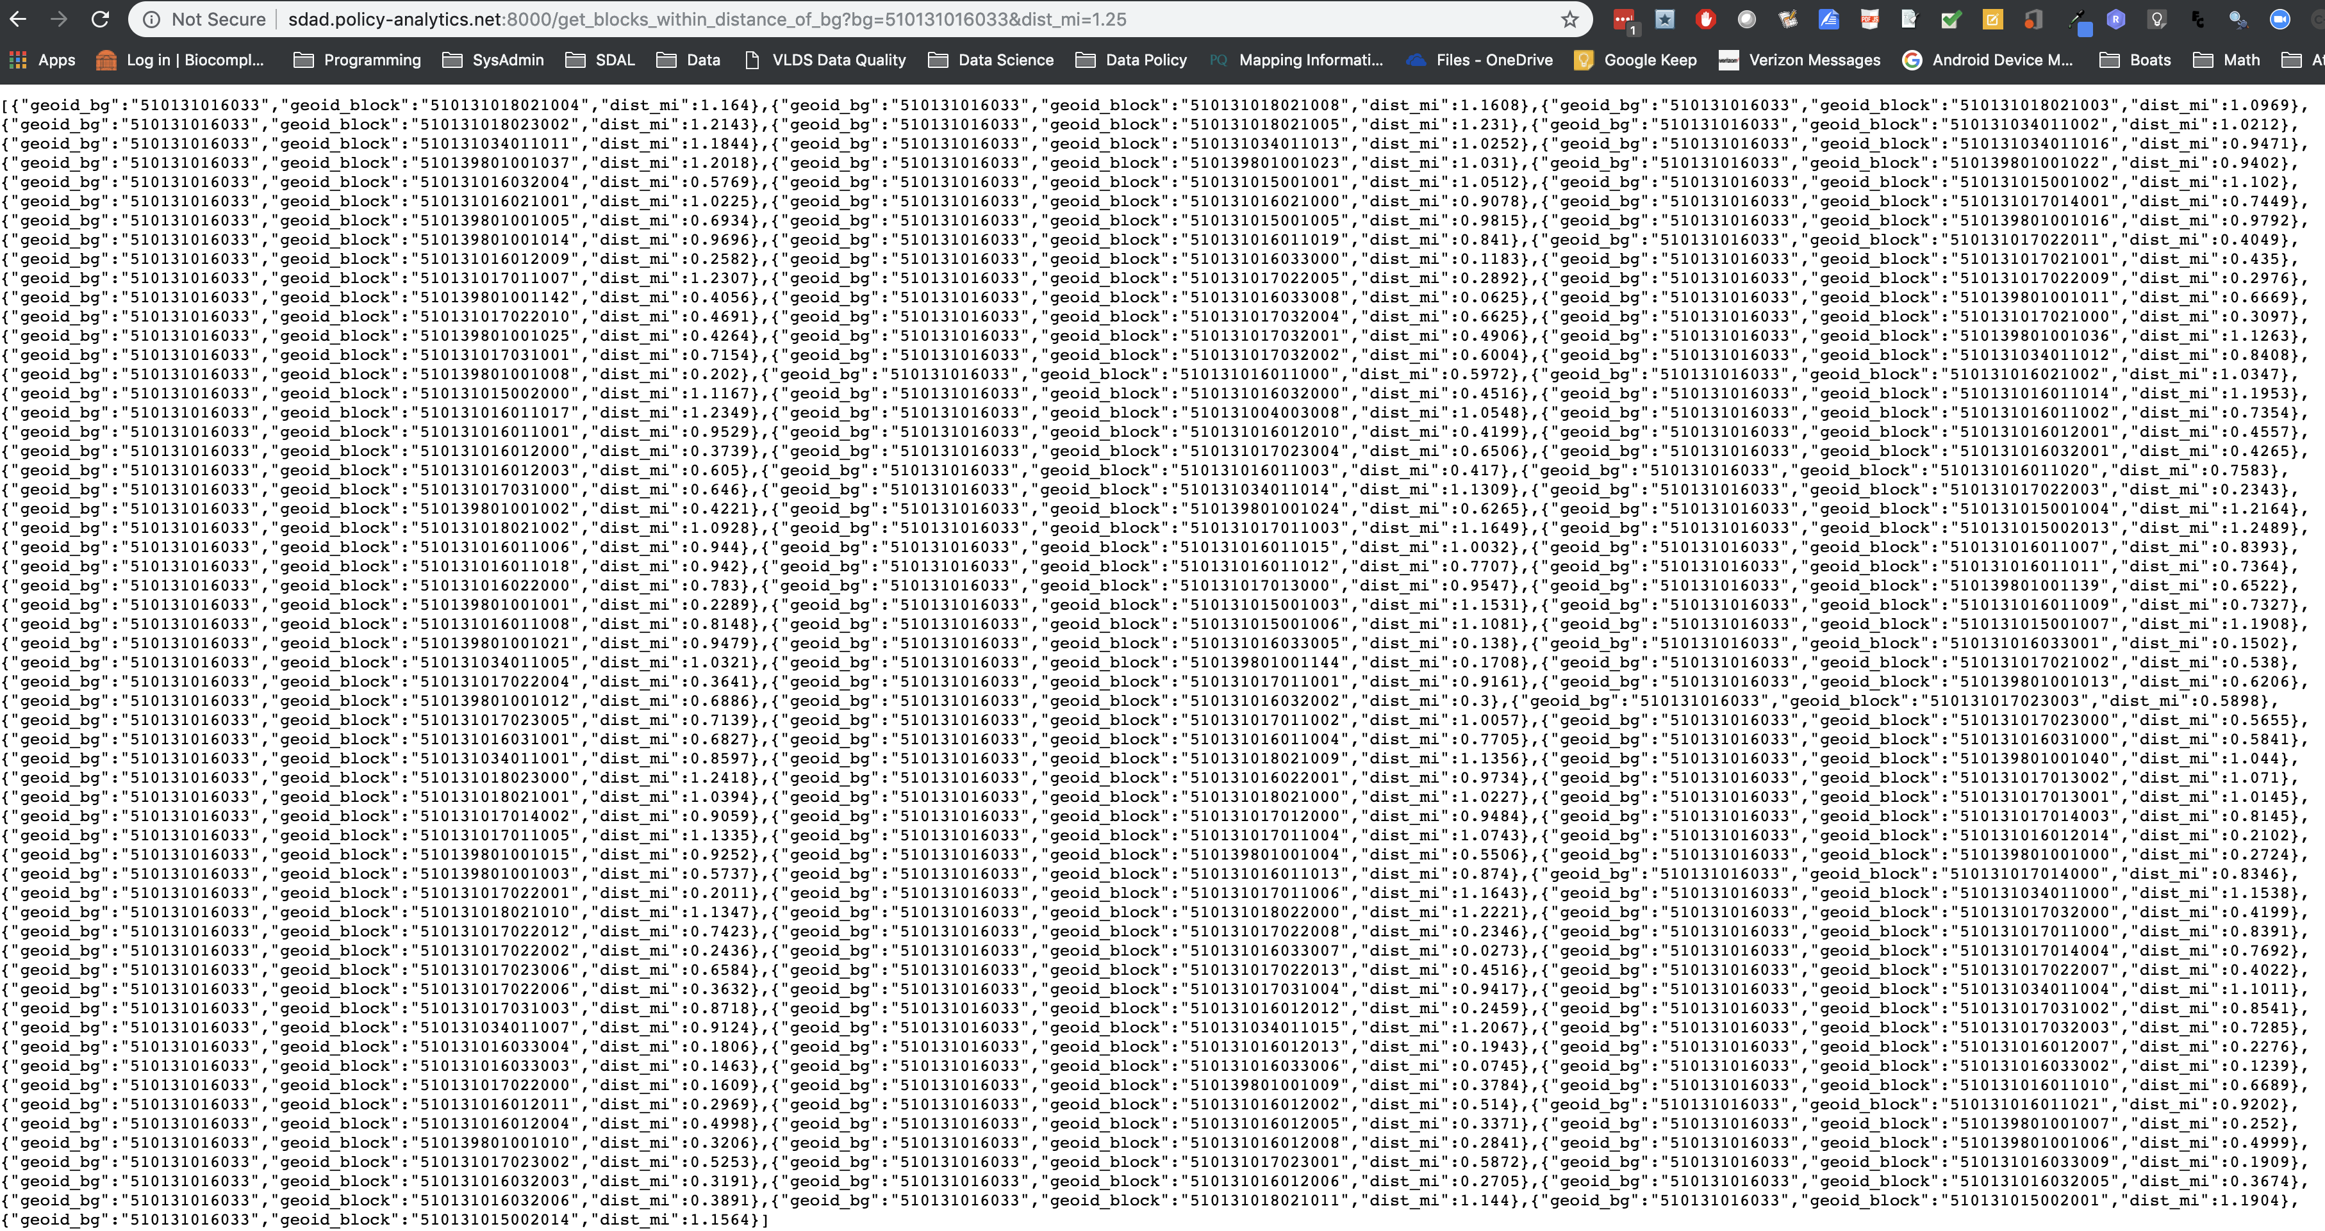
APIs (Plumber, OpenCPU) 1. Distance from BG center-points to Block center-points 2. Gravity model API

Slide 39
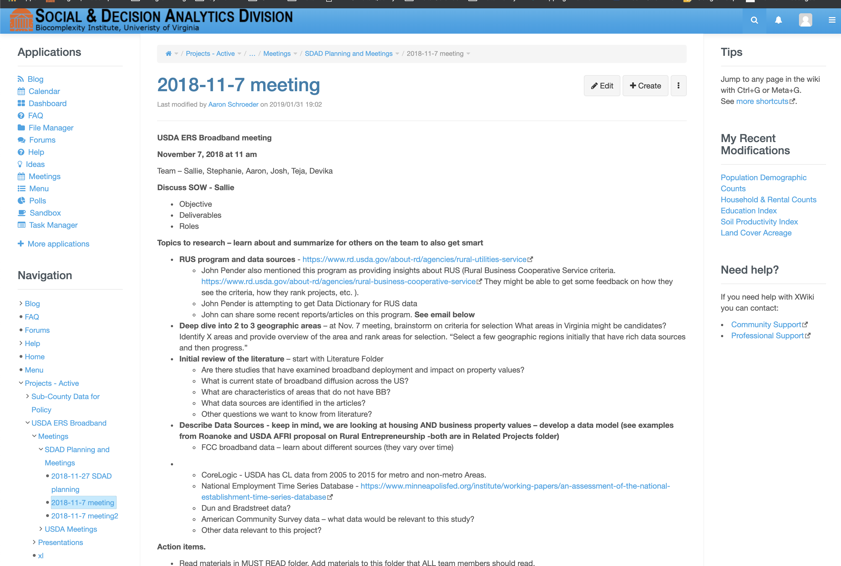
Data Visualization & Sharing Project Wikis (XWiki)

Slide 40
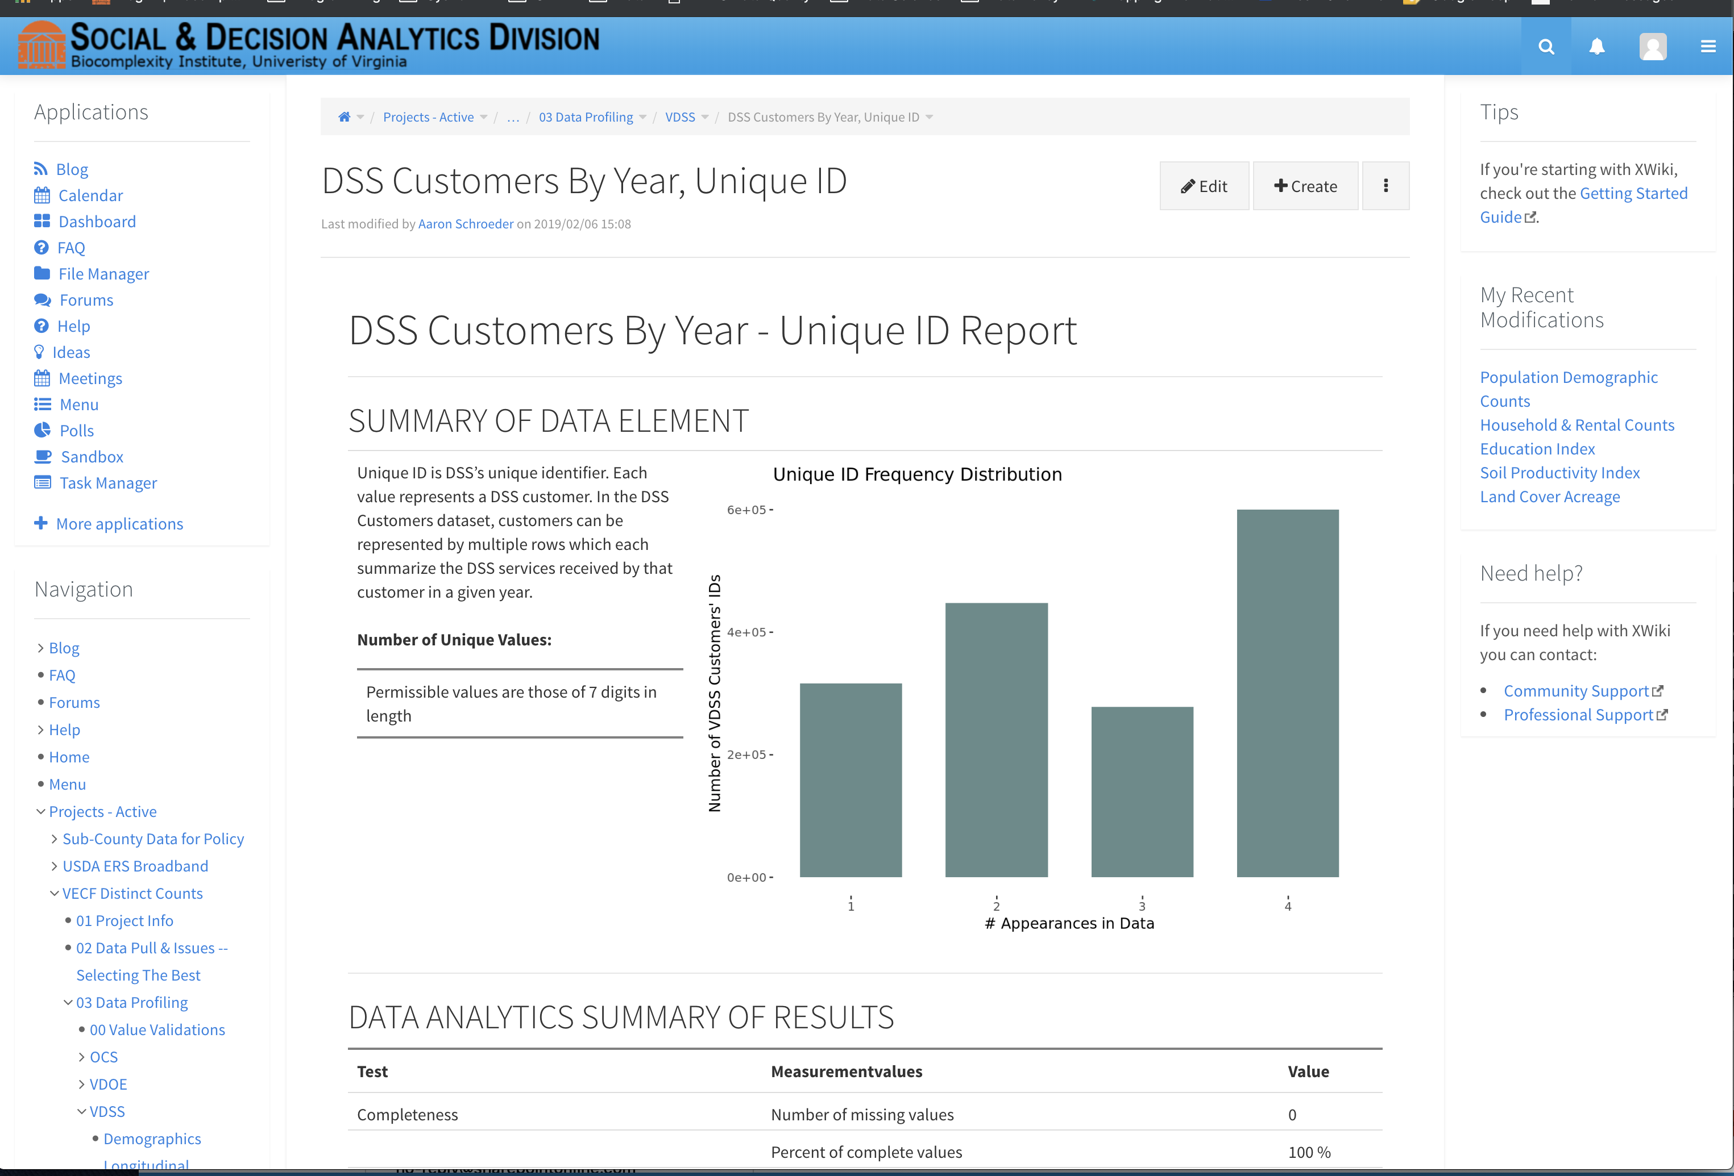
Data Visualization & Sharing Project Wikis (XWiki)

Slide 41
Thank You!

Slide 42
Scenario: Policy Analysis Dashboard for Assessing Possible Transit Route Changes (possibly Marshalltown)
Visually relate three indices
job locations
vulnerable population locations
transit route locations
Project Management (Xwiki Interface)
Project Description
Data Agreements, etc
Ingest (RStudio Interface) - Use different methods for each data source
Jobs, LODES data – API
Transit, GTFS data – Rpkg
Vulnerable – DB
Geography, Census - ftp
Store
Files to secure storage (show Rivanna files interface?)
Store to GIS enabled database – PostGIS (Adminer/Postgres Interface)
Metadata?
Profile
Structural Issues with Jobs data
Quality Issues with Transit Data – Data XPLORE
Prepare
Transformation of LODES data
Analyze & Create
Steps to create Jobs Access Index
Steps to create Transit Access Index
Combine geography with Jobs, Transit, and Vulnerable Index data sets
Visualize & Share
Maps (ERROR ON LODES DATA?)
Shiny Dashboard
Project Wiki
TASKS
Gravity model indices
Employment Access
Coded
Need to run for Marshalltown
Might need to select another locality
Transit Access
Found the data
Need to get right data fields out of it
Need to adapt employment code for transit
Vulnerable Index
Got code from Josh
Need to adapt for Marshalltown
Profile, Prep and Visualize
Need to create walkthroughs
Include something about Code Management - Git

